Slide 1
POSTNATAL DEPRESSION AMONG MOTHERS AT MADINA POLYCLINIC
Dora AWUAH, Paul KUMI, Emmanuel DZIWORNU

Slide 3
OUTLINE
Background to Study
Introduction
Statement of the problem
Justification (Rationale for study)
Literature review
OBJECTIVES
METHODOLOGY
Study type
Data collection techniques
Sample Size & Sampling
Ethical considerations
Results
Recommendations
Acknowledgement

Slide 5
BACKGROUND
Over the years, issues of postnatal depression has been ignored.
Care biased towards physical health
Assessment of pregnant teenagers in 2016, a high prevalence was observed
Location of Madina Polyclinic readily makes it accessible to all cadre of persons
High patronage of maternal health care services in Madina Polyclinic
200 to 220 averagely in a month

Slide 6
Introduction
Depression is an illness characterised by persistent feeling of sadness and a loss of interest in activities that one usually enjoys,
accompanied by an inability to carry out daily activities,
for at least two weeks (WHO, 2017).
Global prevalence of 18% (2005 to 2015).
Ranked as the 4th leading cause of disability worldwide (WHO, 2015)
Projected to be the leading contributor to disability by 2020 ( Murray, CJL & Lopez, 1996).

Slide 7
Intro cont’d
The overall prevalence is about 10% in pregnant women and 13% of postnatal mothers
10-15% of women suffer it after delivery in the United States (Liberto, 2012).
About 60% of mothers in different cultures experience PPD (Monzon, Lanza di Scalea & Pearlstein, 2014),
Prevalence rate in developing countries comparatively higher (Bener, Burgut, Ghuloum & Sheik, 2012)
In Ghana, Gold, et al. (2012) reported a rate of about 9.8% among a clinical sample,
Guo et al., (2013), reported a rate of 7.2% to 8.9% non clinical sample
However, general prevalence among Africans still remains unclear.

Slide 8
Intro cont’d
Causal factors:
Includes preterm delivery, still birth, spontaneous abortion, low social support and financial constraints (Amankwah, 2003; Callister, Beckstrand & Corbett, 2011).
Affects maternal health, parenting, maternal bonding and the emotional development of the baby (Liberto, 2012).
Symptoms include loss of interest in activities once enjoyed,
Crying spells,
Decreased energy,
Feelings of worthlessness and guilt,
Refusal to feed and care for baby, (Monzon, Lanza di Scalea & Pearlstein, 2014).

Slide 9
STATEMENT OF THE PROBLEM
The health implications of PPD on mother, child and the entire society
High prevalence globally (WHO, 2017), in developing countries, among Ghanaians (7.9% to 9.8%) Guo et al., (2013) & Gold et al. (2012),
Limited studies, small sample size, limited clinical research in Ghana (Field, 2010; Gold, Spangenberg, Wobil & Schwenk, 2013).

Slide 10
LITERATURE REVIEW
About 19% of mothers returning to work after childbirth reported significant symptoms of depression (Beth, Lauren & Katie, 2017).
Sample involved 124 mothers ranging from age 18-42 who were 7 months postpartum and first time mothers.
Similarly, about 700 women in their 7th month postpartum were studied to examine their employment status on depression.
The results indicated that the employed mothers were less likely to suffer depression compared to those unemployed
(Gyerdingen, McGovern & Attanasio, 2014).
However, results cannot be generalized

Slide 11
LITERATURE REVIEW CONT’D
In terms of social support, Negron, et. al (2013) examined social support and postpartum depression.
Mothers were grouped into four diverse ethnic groups.
Sample of 33 mothers in a large urban teaching hospital in New York City.
Participants were 6-12 months postpartum.
Data transcripts were reviewed and analyzed for themes.
Support from partners and families was expected
Racial/ethnic differences existed in the way women from different groups mobilized support from their support networks.

Slide 12
AIMS OF THE STUDY
To investigate the relationship between age and depression among mothers after delivery
To establish the association between parity and depression among mothers after delivery
To examine the relationship between mothers’ need for support and depression after delivery

Slide 13
Hypotheses
There will be a significant relationship between age and depression among mothers
There will be a significant relationship between parity and depression among mothers after delivery
Mothers with higher sense of need for support will exhibit a significantly higher level of depression than those with lower sense of need for support

Slide 14
METHODOLOGY
Study design
Survey
Population:
Mothers attending postnatal clinic at Madina Polyclinic, Kekele
Sample:
303 (collected over a period of 3 months)
Incusion criteria
Attend PNC at Madina Polyclinic
At least 7 days to 6 months postpartum
Willingness to participate
Baby alive or dead

Slide 15
Methodology cont’d
Exclusion criteria
Day 1 to 6 postpartum
Diagnosed with an existing mental disorder

Slide 16
METHODOLOGY CONT’D
Ethical consideration
A written permission was sought from the ethical review committee of the Ghana Health Service and management of Madina Polyclinic, Kekele.
Participants were given the opportunity to partake, drop out or withdraw during the process.
Consent forms were filled.
Anonymity and confidentiality ensured.

Slide 17
Results
Table 1: Demographics of participants
Demography | Frequency | Percentages
Age [Mean (SD)] 22.13 (3.40)
Education
None | 40 | 13.2
Basic | 181 | 59.7
SHS | 67 | 22.1
Tertiary | 15 | 5.0
Occupation
Teacher | 6 | 2.0
Nurse | 1 | .3
Trader | 168 | 55.1
Farmer | 1 | .3
Unemployed | 63 | 20.8
Other | 64 | 21.1
Marital status
Married | 219 | 71.9
Single | 81 | 26.7
Widowed | 3 | 1.0

Slide 18
Hypothesis1: There will be a significant relationship between age and depression among mothers Hypothesis 2: There will be a significant relationship between parity and depression among mothers after delivery
Table 2: Pearson Correlation showing relationship between age, parity and depression
 | Mean | Std. Deviation | Age | Parity | Depression
Age | 22.13 | 3.40 |  | .568** | .024
Parity | 2.04 | .85 |  |  | .116*
Depression | 26.26 | 3.88
**significant at .01, *significant at 0.05

Slide 19
Hypothesis 3: Mothers with higher sense of need for support will exhibit a significantly higher level of depression than those with lower sense of need for support
Table 3: Independent t-test comparing mothers who need support and those who do not need support
Groups | N | Mean | Std. Deviation | df | t | p
Need support | 136 | 25.10 | 3.90 | 301 | 4.87 | .00
No need of support | 167 | 27.20 | 3.62

Slide 20
Interventions
Further Assessment with DASS 42
In-depth interview
Cognitive behaviour therapy sessions
Home visit
Psychoeducation
Progressive muscle relaxation exercise
Family/couple therapy

Slide 21
Recommendations
Pregnant and postnatal mothers should be routinely screened for depression
Periodic training of Midwives in mental health assessment and basic counselling skills
Strong collaboration between Maternal and Mental health teams in all health facilities
Pregnancy school policy should be implemented in all health facilities providing ANC
Health education in public health facilities should be simplified and also illustrated with diagrams
Training in vocational skills should be included in the pregnancy school programme/ antenatal services
Counselling sessions for both pregnant and postnatal mothers
Family should be encouraged to reduce number of children

Slide 22
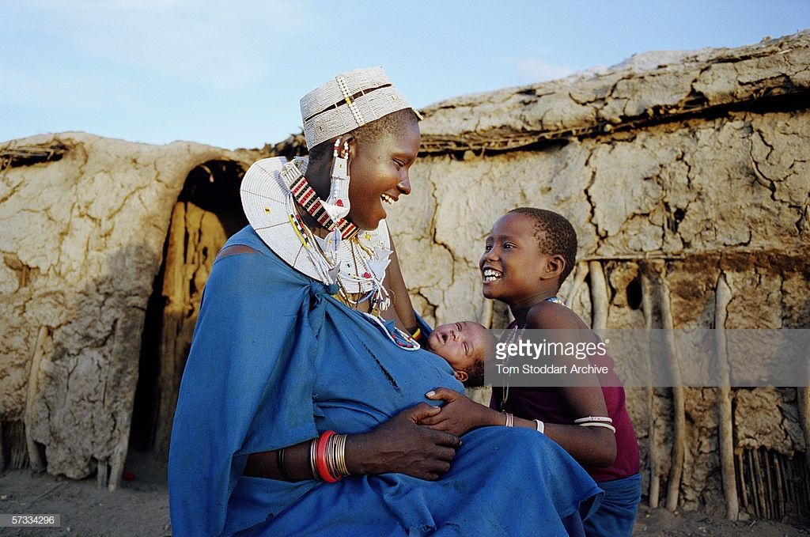

Slide 23
Acknowledgement
Ghana Health Service
Management of Madina polyclinic
Postnatal mothers
Staff of mental health unit, Madina Polyclinic
Staff of maternity unit
Organizing committee of Mental

Slide 24
References
Amankwaa, L.C. (2003). Postpartum Depression, Culture and African American Women. Journal of Culture Diversity, 10, 23-37.
Atefoe, E.A. (2013). Mental Health among Women in Accra: The Effects of Religiosity, Social
Support and Social Negativity. An Unpublished Thesis, University of Ghana
Beth, A. L., et al (2017). The relationship between employment status and depression symptomatology among women. Journals.Sagepub.com.
Bener, A., Burqut, F.T., Ghuloum, S. & Sheikh, J. (2012). A Study of Postpartum Depression in a Fast Developing Country: Prevalence and Related Factors.
International Journal of Psychiatry Medicine, 43, 325-337.
Callister, L.C., Beckstrand, R.L. & Corbett, C. (2011). Postpartum Depression and Help Seeking Behaviors in Immigrant Hispanic Women. Journal of Obstetric
Gynecology Neonatal Nursing, 40, 4, 440-449.
Cox, J.L., Murray, D. & Chapman, G. (1993). A Controlled Study of the Onset, Duration and Prevalence of Postnatal Depression. British Journal of Psychiatry,
163, 27-31
Cox, J.L., Holden, J.M. & Sagovsky, R. (1987). Detection of Postnatal Depression: Development of Postnatal Depression: Development of the 10-item Edinburgh
Postnatal Depression Scale. British Journal of Psychiatry, 150, 782-786.
Field, T. (2010). Postpartum Depression Effects on Early Interactions, Parenting and Safety Practices: A Review. Journal of Infant Behavior Development, 33, 1-6.
Field, A. (2009). Discovering Statistics Using SPSS (3rd ed). London: Sage publications Ltd
Negron, R., Martin, A., Almog, M. Balbierz, A. & Howell, E. A.(2013). Social support during the social during the postpartum period mothers’views on needs, expectations and mobilizing support. Maternal and Child Health Journal, 17,616.

Slide 25
THANK YOU

