Slide 1
Expectations and experiences of individuals with mental illness at the Mount Horeb prayer camp in Ghana
Gyimah L, Ofori-Attah A, Curry L

Slide 2
Funding is from the NIH through the Fogarty International Centre under the GHES award.

Slide 3
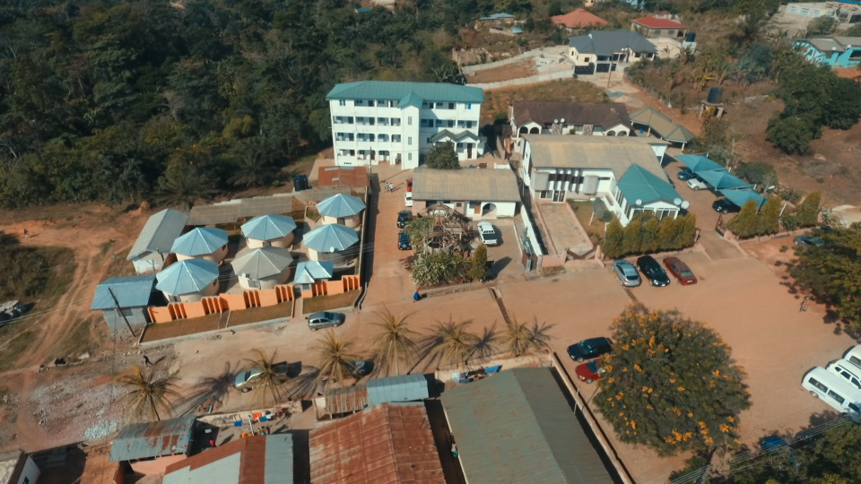
Aerial View of Mount Horeb Prayer Camp

Slide 4
Presentation Outline
Introduction and Background
Problem statement
Aims of the Study
Review of Related Literature
Methodology
Results
Discussion
Conclusion

Slide 5
Introduction
Mental disorders account for 32.4% of years lived with disability (YLD) and 13.0% disability life adjusted years (DALYS) globally [1].
People living with severe mental illness, account for approximately 650,000 of Ghana's population of 21.6 million[2].
The treatment gap (i.e. those individuals who may have mental illness and are not getting adequate treatment) is estimated to be as high as 98% in Ghana [3].

Slide 6
Problem Statement
The Mental Health Law (Act 846, 2012) emphasizes community-based care over institutionalization, the protection of human rights and collaboration with faith based and traditional healers.
The community care approach to mental healthcare has shown better results than the traditional system of institutional care [4, 5]

Slide 7
Though effective treatment is available; it may not be accessible to individuals who need it.
Thus institutions such as prayer camps remain attractive for families to send mentally ill relatives due to many Ghanaians perceiving mental illness as being partly caused by evil spirits or as punishment from a deity influencing their health seeking behaviour[6,7]

Slide 8
Additional reasons include the lack of support for the mentally ill individual or the family. Ghana does not have a welfare system to support the care of the mentally ill directly or indirectly thorough incentives for family members who take care of these individuals and bear the cost of care [8].

Slide 9
Aims of the study
To explore the expectations and experiences of persons with mental illness receiving care at a faith based institution.
To explore from the patients perspectives how care at the psychiatric hospitals or other treatment settings compares with the above.

Slide 10
Methodology
Study setting :Mount Horeb Prayer Camp
Study Design :Mixed Methods
Population : Persons seeking healing for mental illness at the Mount Horeb Prayer Camp
Sample size and sampling Technique : 23, Purposive sampling
Data Collection : Interviews, SCL-90, Stigma Scale, Rosenberg Self esteem scale, Demographic questionnaire
Procedure
Analysis of data : Thematic content analysis
Ethical considerations : informed consent, privacy etc

Slide 11
Results
1. Expectations
2. Experiences
Two major Themes
Chaining
Treatment approaches

Slide 12
Expectations
The decision to come to the prayer camp, about 8 out of 10 (n=18) said they were brought there without prior consultation. Caregivers were the decision makers.
Thus most of these expectations were not considered prior to the visit to the camp.

Slide 13
My mother forced me to come.(Respondent 19)
No. I was told I was going to church. I didn’t know this place would be like this. If I knew and I came here and I saw… I never knew I’d be in chains. If I knew that this is how the place will be like; if I saw it, I would have gone back to my parents’ car.(Respondent 20)

Slide 14
Healing was the most indicated expectation from the encounter
I was expecting to be healed. And by God’s grace I am fine now.
(Respondent 1)
What I am looking for is that God will heal my husband and that I will also get healing from these illness that worry me alongside. So whichever grace God will grant me with I will be grateful so I can go back to do God’s work. So that was the main thing. However, when the sickness occurred I did not come here so we are using this as an opportunity to pray for healing as well. (Respondent 2)

Slide 15
Individual’s experiences with chaining as a form of treatment.
The Theme chaining was defined as physical restraints using chains
5 sub-themes were employed to explain this theme
  Experiences when in chains
  Chaining in different faith based camps
  Forced/unexpected/unforeseen chaining
  Perceived positive effects of chaining
  Negative Experiences with Chaining

Slide 16
Individuals describes physical pain and suffering, feeling unclean and fears of going back to chains
… While in chains, I fell sick because I was virtually naked lying there always and I has sores in my mouth so I could not eat properly (Respondent 2)
… I was in chain for seven (7) months …..There were periods I was released to lie down for some time, then after some time they asked that I be locked back in chains (Respondent 23)

Slide 17
…I was in chains …. Oh I feel so terrible! I want to be able to walk, bathe, and look good (Respondent 22)
… Yeah I was in chains… But I don’t see why a human being should be chained. So I thank God my master has released me from chain, and I hope not to go back; I’m comporting myself…. (Respondent 20)

Slide 18
Chaining in other faith based camps
When I fell sick initially, I was taken to Bremano Prayer camp in the Brong Ahafo Region where I was put in chains under a particular tree… . I was also taken to Gyegyemreta in the same town but another prayer camp, there too I was put in chains… was then taken to Abotaase, that is where I gave birth to my baby girl I was in chains when I felt the pains of delivery … (Respondent 2)

Slide 19
Yes, I have been to Pankese. People are chained there too … . And also, in other places you are not even catered for. But here, we are well taken care of. Sometimes they take you out of chains to take your bath … (Respondent 6)

Slide 20
Unexpected /unforeseen chaining
We went to see the prophet and he took me inside and chained me. Once you were told you are being brought here, you are likely to run away … (Respondent 6)
Oh I was just asked by my mom to see a pastor, and as I came, before I realized I was chained! (Respondent giggles) …. (Respondent 2)
The practice is deceptive and violates the rights of the victims by not seeking their consent.

Slide 21
Perceived positive effects of chaining
… A lot of people complain when they are in chain. But others too say the chain has helped them rather … me I’m still here, because when I’m not in chain I roam. Those days when I’m not in chains I walk about. But when they brought me here they put me in chains for about three or four weeks. Before one month I became sober…, I like it like that. When you leave you’ll do certain things you may not like to do … (Respondent 5)
I see that the chains are capable of driving away evil spirits. … (Respondent 6)

Slide 22
The extracts above, reveals a respondent who sees the importance of being in chains from inferably his chats with people who are either out of chains or have had episodes in and out of chains. He moves on to talk about what he used to do when he was out of chains as justification for why he should be chained.

Slide 23
Negative Experiences with Chaining
The chain I see it to be torture; like being like a prisoner. Why should a human be in chains? Are we animals? Even dogs are not in chains; dogs are in, you understand? Okay my dog is in chain, but what hooks the neck is not a chain; it’s a belt… I don’t want to go back to those chains because it’s very painful. Sleeping in chain? Oh why? I’m not an animal; I’m human. Why should I sleep in chains and you sleep comfortably? It’s not fair … (Respondent 20)

Slide 24
Treatment
The treatment major theme, explored the experiences of respondents with regards to medications, both conventional and unconventional. It also examined a combination of both approaches depending on the predominant belief of the relative or help seeker.
Two main themes were identified
  Orthodox treatment
    Positive
    Negative
  Unorthodox treatment

Slide 25
Positive orthodox treatment
For Pantang the treatment was much better in fact they treated me well. I was sedated and made to sleep for some time so when I woke up I could get up and go and chat with the people there. Over there, they treated me well and their food was nice … (Respondent 2)

Slide 26
Negative orthodox treatment
At the hospital, one thing I realized is that if you take too many medications it spoils your life. You can have a twisted mouth, trembling and stiffness of limbs. But since I stopped taking the medications I have not had such experiences … (Respondent 6)

Slide 27
Unorthodox treatment
I can’t… You see, to me I’d say; it’s like my parents see it to be part of the medication. Aside the drugs I take the herbal, so I’m on the herbal, and I’m on the “medicinal” drugs too…. I attend church and they also give me some herbal medicines to take in … (Respondent 20)

Slide 28
Discussion
The overall impression of the treatment received in the prayer camp, particularly with regards to the chaining was negative.
Participants were tricked and/or forced into the chains and most found the experience to be dehumanizing.
The practice of chaining is widespread and participants had been chained in multiple camps prior to being chained in this camp
These points highlight the grave abuse of human rights that the act of chaining represents

Slide 29
Discussion
There were also participants who appreciated the chaining and welcomed it as a form of treatment. This raises the question that should the chaining of such people be allowed to continue if they choose it as their preferred form of treatment?
The solution to the problem of chaining might require a more nuanced approach to cater for the needs of such patients.

Slide 30
Discussion
The treatment received from orthodox care givers left both positive and negative impressions.
Participants were happy with the formal non chaining approach to care but we're not happy with the side effects of the medications used
More care should be taken by orthodox care givers to reduce the adverse effects of the treatments offered
This may help to reduce the number of people ending up in chains whilst seeking help from other sources

Slide 31
Conclusion and Recommendation
There is a need to address both the spiritual and orthodox approach to care.
Education of patients and caregivers on medication and side effects.
Clinicians need to manage side effects promptly and possibly use newer medications with less side effects.

Slide 32
References
1 Vigo, D., Thornicroft, G. and Atun, R.(2016). Estimating the true global burden of mental illness. TheLancetPsychiatry,3:(171-8). doi:http://dx.doi.org/10.1016/S2215-0366(15)0050-2. Retrieved on August 20, 2017.
2. World Health Organization. Ghana country summary. (2007). Mental health improvement for nations' development (MIND). Geneva: Department of Mental Health and Substance Abuse. http://www.who.int/mental_health/policy/country/GhanaCoutrySummary_Oct2007.pdf. Accessed February 15, 2015.
3. World Health Organization. WHO Mental Health Atlas. Available at http://www.who.int/mental_health/publications/mental_health_atlas_2011/en/. Accessed February 15, 2017.

Slide 33
5.World Health Organisation- Community mental health service will lessen social exclusion. www.who.int/mediacentre/news/notes/2007/np25/en/. Accessed on 16th April,2018.
6Thornicroft, G., Tansella, M., (2003) what are the arguments for community-based mental healthcare? Copenhagen, WHO Regional Office for Europe( Health Evidence Network report;http://www.euro.who.int/document/E82976.pdf, Accessed 16th April, 2018)

Slide 34
6.Ewusi-Mensah, I., Post-colonial psychiatric care in Ghana, Psychiatric Bulletin(2001), 25,228-229.
7. Stefanovics, E.A., He, H., Cavalcanti. M., Neto, H., Ofori-Atta, A., Leddy, M., Ighodaro, A. and Rosenheck, R. (2016). Witchcraft and biopsychosocial causes of mental illness: Attitudes and beliefs about mental illness among health professionals in five countries. J Nerv Ment Dis. 2016;204 (3):169-174.

Slide 35
