Slide 1
Establishing a family support group in community mental health in Ghana
Ithiel Korkor Zotorvie, Fauzia Ibrahim¹, , Apoyongo Maclean¹, George Kunyangna¹, Isaac Agyei¹ Peter Adams¹, Ursula Read²
¹ Kintampo College of Health, Ghana
² Kings College London
Notes:
Talk about a family support group established by community mental health workers in Ghana – want to acknowledge their initiative, hard work and enthusiasm in setting this up.
Presenting to share their work and hopefully to get some ideas as to how the group could be developed

Slide 2
Family care of mental illness in Africa
Role of family in care long been considered to be a factor in determining outcome of mental illness in Africa
Deinstitutionalisation – family/community care considered best practice
WHO Action Plan for Mental Health (2013-2020) advocates the ‘empowerment and involvement’ of families in mental health care
Most people with mental illness in low-income settings live with family members who manage day-to-day care
Families affected by mental illness often poorer, with less access to resources
Fragile health systems, lack of resources may impact on viability of community-based care, increasing reliance on families
Notes:
Family – colonial observers – thought that African families appeared more tolerant, absence of asylums they were the only source of support, WHO studies suggested that there were better outcomes for schizophrenia in developing countries and hypothesised this might be due to greater family support
International actors in mental health recommened deinstitutionalisation and community care as optimal – this means people with mental illness remaining in the family where possible and being treated through primary care, or community-based mental health care, rather than in psychiatric hospitals
In low-income settings most people live with the family not necessarily due to any policy or preference, but simply due to the absence of any alternative.
Poverty –either due to the effects of the illness on productivity of the person affected, and of carers, and costs of care, or due to the fact that people living in poverty are more likely to become mentally ill – referred to as ‘viscious cycle of poverty and mental illness’
Structural adjustment, and limits on public sector expenditure have had significant impact on health systems in low-income countries, so there is increasing reliance on families to provide care

Slide 3
Context in Ghana
Families under increasing pressure – changes in household composition (divorce, migration etc.), vulnerable employment, rising cost of living
Research in Ghana with families with a relative with psychosis showed high burden of care, with little support (Read 2013; AeNgibise 2015)
Policy commitment to increase access to community-based mental health care (Mental Health Act 2012)
National mental health budget estimated to be US$0.12 per capita, mostly absorbed by psychiatric hospitals - no budget for community care (Roberts et al 2013).
Notes:
Economy has deteriorated since 2012, decline in revenue from major exports, depreciation of the currency, rising cost of living (food, electricity, fuel etc), 77% in vulnerable employment (self-employed, fluctuating earnings), levels of migration remain high – impact on households, female-headed households common

Slide 4
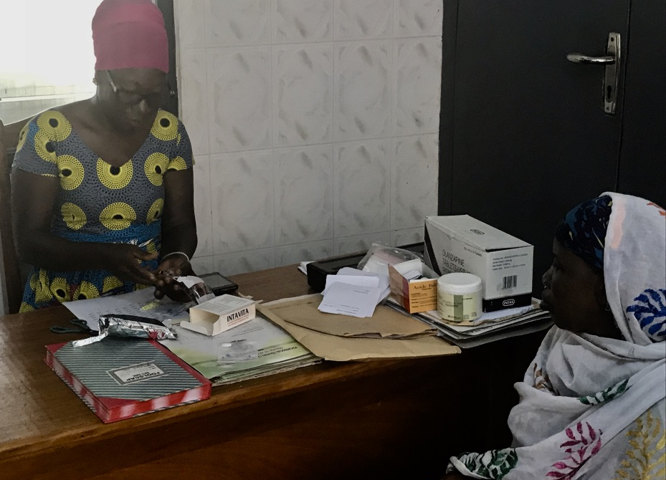
Psychosocial Centre, Kintampo College of Health
Since 2011 new community mental health officers (CMHOs) trained at Kintampo College of Health
Psychosocial Centre - training for CMHOs, staffed by Clinical Psychiatric Officer, CMHOs, RMN, psychologist
Offers mental health treatment to community – clinic, home visits
Funded by College of Health and Ghana Health Service
Some support (training, book donations etc.) from partners in UK
Lack of ring-fenced budget for mental health at municipal level
No transport/fuel for community visits, frequent interruptions of medication supply
Notes:
Was able to attend the group several times in 2016. Several of the family members I had met during my PhD were attending and accessing treatment. Observed the group, spoke to group members

Slide 5
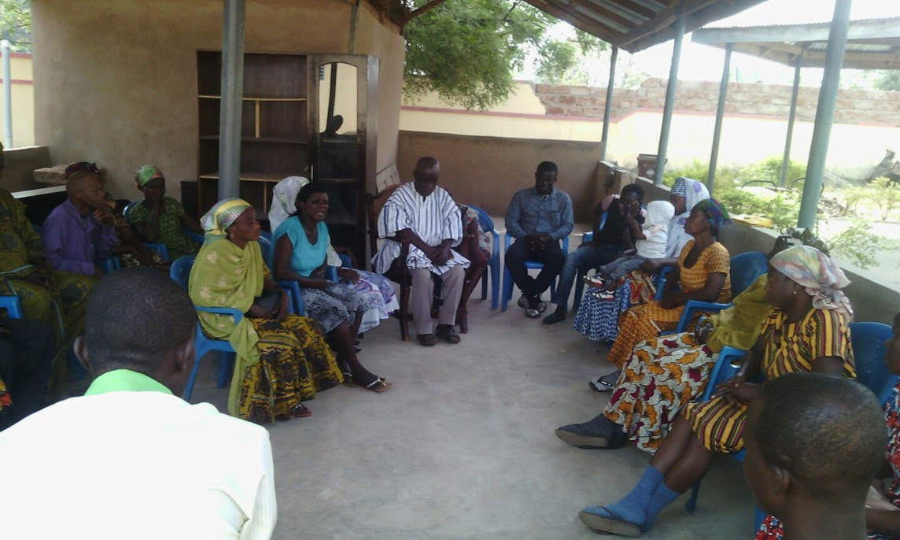
How the CAREGIVERS’ FOUNDATION began
2015 MHWBF Conference in Accra
Two presentations motivated the idea
1st meeting on 24th December, 2015

Slide 6
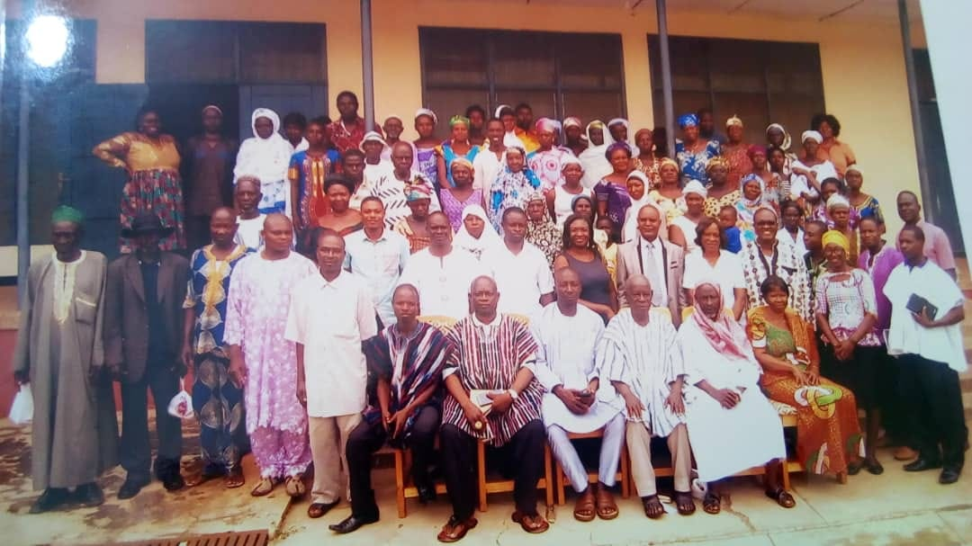
Inauguration 8th August 2016

Slide 7
Aims of the family support group
Promote community awareness of mental illness and reduce stigma and discrimination
Support social integration and rehabilitation, including participation in family and community activities, training and employment
Facilitate access to medical and psychosocial treatment
Exchange information on symptoms and experiences to identify best practices and ways of responding to challenging behaviours
Identify community resources, and facilitate access to benefits and entitlements
Fundraise
Notes:
High levels of stigma and social exclusion
People with severe mental illness often not engaged in work, or even household chores as expected. Studies, training or employment often disrupted by the illness, often social excluded – few friends or other social interaction
Certain benefits available to poor in Ghana but may be difficult to access -
LEAP is a social cash transfer program which provides cash and health insurance to extremely poor households across Ghana. LEAP eligibility is based on poverty and having a household member in at least one of three demographic categories: households with orphan or vulnerable child (OVC), elderly poor, or person with extreme disability unable to work. Small amount – about 200 cedi per quarter. Funded by DFID.
NHIS – health insurance scheme in operation since 2004 - exemptions for ‘indigent’ – strictly speaking, not working, homeless, no one to care for them – poor less likely to enroll

Slide 8
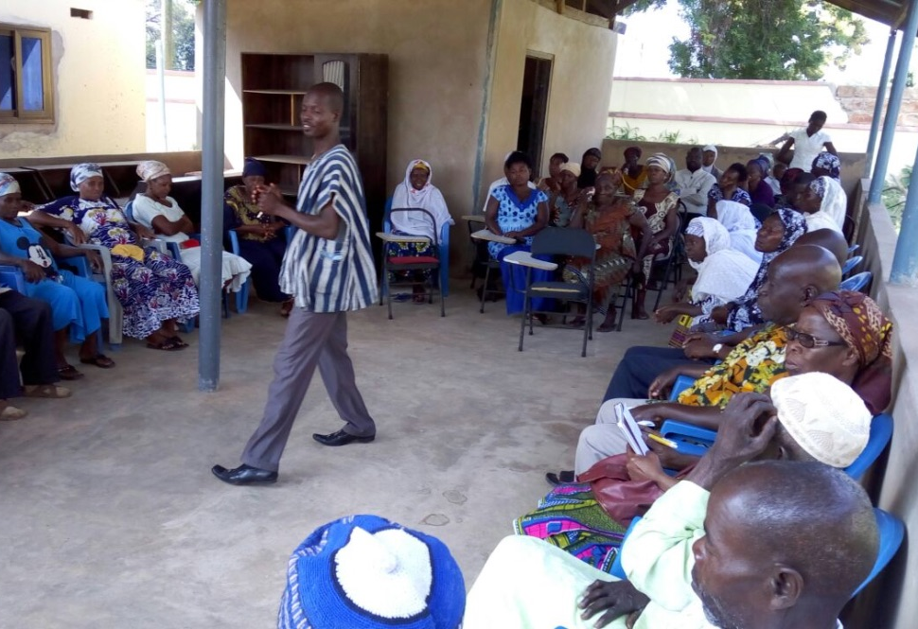
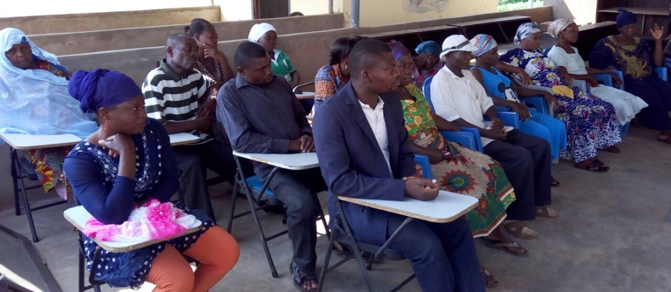
Progress so far
Meets every 2 weeks
Covers Kintampo municipality
385 family carers have been registered - 182 male, 203 female
An average of 75 people attend each week
Usually consists of talk by the CMHO, followed by questions and discussion
Topics covered: education on mental illness, medication side effects, adherence to medication, best practices in care (individual experiences and innovations), ideas for income generation
Clinic held following the meeting for review and medication refills etc.
Notes:
People attending included at least 8 people from the families I met during my PhD research in 2007-8.Some began attending in May after I visited on fieldwork:
Memenatu’s father
Mawia’s father
Ceci
Sumaila’s father
Yaa Yaa
Enunam Donkor’s mother
Pasta Rasta’s mother
Ama Aban’s mother
Clinic runs after the group so that group members can be reviewed and get medication refills. Psychologist also available for appointments
I hear discussions on medication side effects, ways of supporting adherence e.g. hiding meds in food, possible spiritual causes, problems experienced in providing care - e.g. person sleeping, loss of engagement in activities

Slide 9
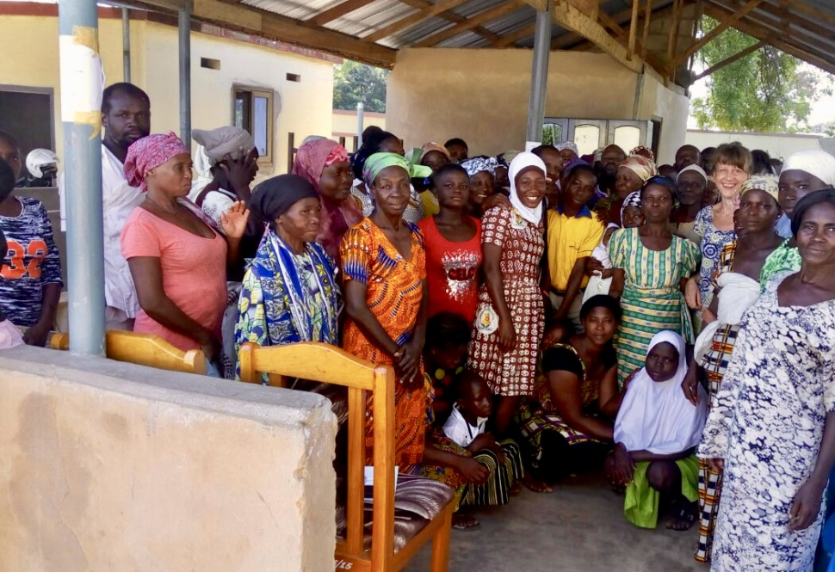
Improved access to regular treatment and advice
Improved attendance for review and follow-up
Decreased relapse
Collaborations established with, among others, local departments of social welfare, education, and agriculture, the National Health Insurance Scheme, and NGOs
Successfully advocated with local and regional agencies on behalf of group members
Members enrolled on NHIS and LEAP
Access to disability Common Fund for medication
Members actively participate in the group, sharing experiences of treatment and care
Sense of solidarity and support among group members
Achievements
Notes:
Representative from NHIS visited the group to enroll people
Draws on aspects of social life and values that may enhance the popularity and success of the group. Sharing experiences and advice in the event of misfortune is common practice in Ghana – most common way of accessing information? e.g. in PhD research most people had decided to use a particular healer because he/she was recommended, likewise people will attend psychosocial centre and get medicines for their child on the advice of others (e.g. Kwaku Duah’s mother)
Mutual help and support – loaning money, helping out neighbours is commonplace
Example: Cecilia stood up and spoke about her own experience of taking medication – how the old medication used to make her sleep, but now she was taking a different medication and she was fine

Slide 10
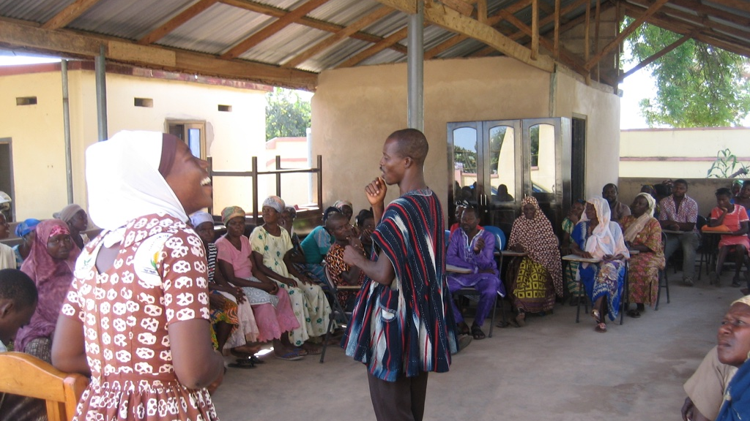
Notes:
Value of humour – comedy as well as tragedy in mental health

Slide 11
Challenges
Erratic supply of medications
Members struggle to provide care due to poverty and lack of access to resources
Members find it difficult to make financial contributions to raise capital for income generating activities.
No funding for the group
Methods primarily didactic – rehabilitation, income-generation and other methods hampered by lack of resources and skills
Notes:
What about those who have no family? Homeless (vagrants)

Slide 12
Next steps
How can we keep the group going?
How can we increase the involvement of people with lived experience of mental illness?
How can we develop more rehabilitation/social integration activities?
What resources/assets can be mobilized?
How can we raise funds in a sustainable way?
Notes:
How successful can family support groups be where there is very limited access to publicly funded mental health treatment?
What does service user involvement and empowerment mean in this context? Survivor/user stance does not necessarily fit well with African experience – more about access to treatment, than protesting abuse of psychiatry, more comfortable for carers and people with mental illness to work together
UNCRPD – rights – people with disabilities – is this framework useful?
Didactic methods common in this context – public health practice, school and particularly church - do people want a more engaged type of group? Or is imparting knowledge what people want – authority?
Examples of peer support in Uganda, hearing voices group, recovery college

Slide 13
Acknowledgements
Mental Health and Wellbeing Foundation
College of Health and Wellbeing, Kintampo
Staff of the Psychosocial Centre, Kintampo
Patients and caregivers
The Kintampo Project

