Slide 1
A study on Forensic Mental Health Care knowledge, attitudes and practices of criminal justice professionals and psychiatric nurses in Ghana

Slide 2
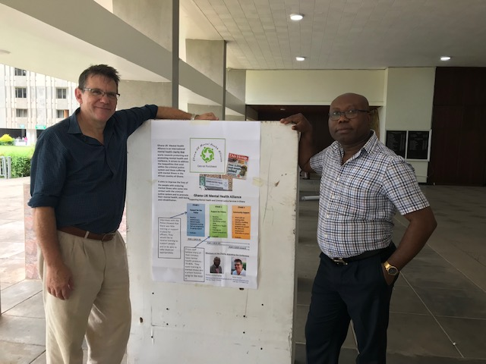
Charles Acheampong
Peter Hasler
Rita De-Graft

Slide 3
Content
What is Forensic Mental Health
What is the Ghana-UK Mental Health Alliance
The Approach we have taken
Findings
Delivery model
Discussions and intelligence

Slide 4
Forensic Mental Health (Psychiatry)
Forensic Psychiatry is a specialty within psychiatry concerned with helping people who have mental disorder and who present a significant risk to the public.
Royal College of Psychiatry

Slide 5
Prisons
Adult Psychiatry
Forensic Mental Health
Courts
Police

Slide 6
March 2018

Slide 7
Ghana-UK Mental Health Alliance

Slide 8
Project Group
David Adjei
Maryland Ocansey
Rita De-Graft
Matthew Agbolegbe
Sam Adoagye
Charles Acheampong
Peter Hasler

Slide 9
Approach Taken
To establish a baseline we have carried out interviews with:-
Police Officers
Prison Staff
Criminal Justice staff (in progress)
Mental Health Nurses (in progress)

Slide 10
Findings (so far)
Police (sample 16)
100% had no training in mental health
62% would try to move someone to a psychiatric hospital (if acutely mentally ill)
Top 3 suggestions for improvements:-
50% wanted access to a mental health nurse (liaison nurse)
43% would want training to support prisoners
37% would like a safe place in the community

Slide 11
Findings
Prison staff (sample 29)
41% had received short training sessions with the psychiatrist
Top suggestions for improvement:
82% of officers would welcome training
65% said there should be nurses and more Doctors in the prison
75% would like to see a community provision for moving on.

Slide 12
Ghana-UK Mental Health Alliance
Supporting Mental Health and Criminal Justice Services in Ghana
STAGE 1
Support for the Police
Baseline questionnaire
Mental Health Awareness training
Roll out programme
On-going support
Evaluate
STAGE 2
Support for Prisons
Baseline questionnaire
Identifying a prison wing
Classify to a ”Health Wing”
Training and support programme
Evaluate
STAGE 3
Community Support
Work with an existing NGO
Identify a building
Establish a day programme around life skills and employment
Alternative to prison
Evaluate
YEAR 1 (2018-19)
YEAR 2 (2019-20)
YEAR 3 (2020 onward)

Slide 13
Your questions
help and advice

Slide 14
References
Roberts M., Morgan C., Asare J.B., (2014) An Overview of Ghana’s mental health system: results from an assessment using the World Health Organisation’s Assessment Instrument for Mental Health Systems (WHO-AIMS) International Journal of Mental Health Systems, 8,16
The Mental Health system in Ghana (2013, Kintampo Project/Ministry of Health
Key Informants interviews, November 2017

Slide 15
Funding Solutions
Ultimately the Ghana Government will need to make adequate provision as a % of GDP for mental health.
In the shorter term project funding is being explored to run the model in one geography in Accra- one police station and one prison.

