Slide 1
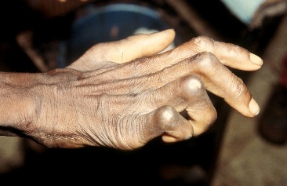
Community Service ProjectS AND IMPACTS: dUTA Community (water Project) & Godokpe Community (Cured lepers support project)
Authors: CHRIS KEWLEY, Divine Kporha, Prince Ababio Osei, Elorm Ntem, Sosu Patricia, Richard Quainoo.
UNIVERSITY OF HEALTH AND ALLIED SCIENCES, GHANA.
UNIVERSITY OF NEWCASTLE, AUSTRALIA.

Slide 2
VOLUNTEERISM
Generally is considered to be a self-sacrificing activity where an individual or group of people provide services for no financial gain to benefit another person, group or organisation.
Volunteering is about giving, contributing, and helping other individuals and the community.
Volunteering means working alone or with others to ensure a meaningful contribution is made towards achieving a better community.
(Osei, K. & Aryee J., 2018)

Slide 3
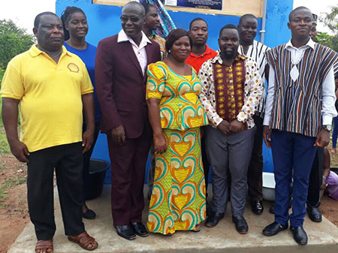
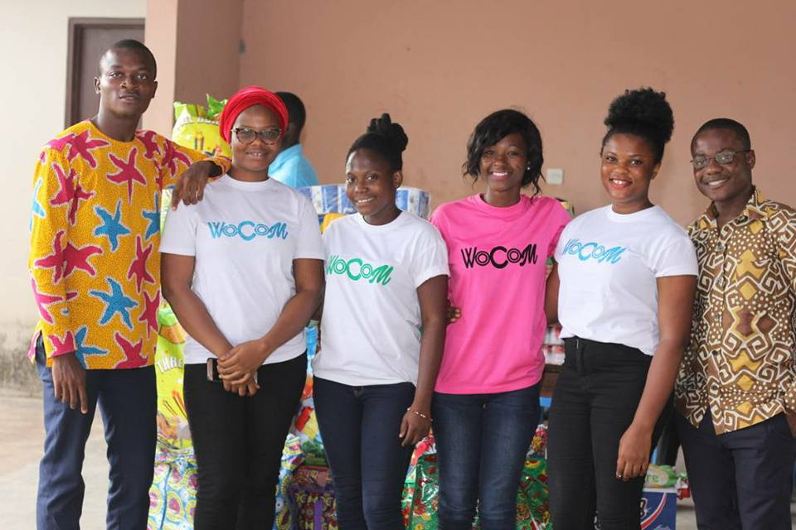
TWO MAJOR COMMUNITIES UNDER STUDY
UHAS team EMBAK provides mechanised borehole to Duta community
Godokpe Community (cured lepers support project)

Slide 4
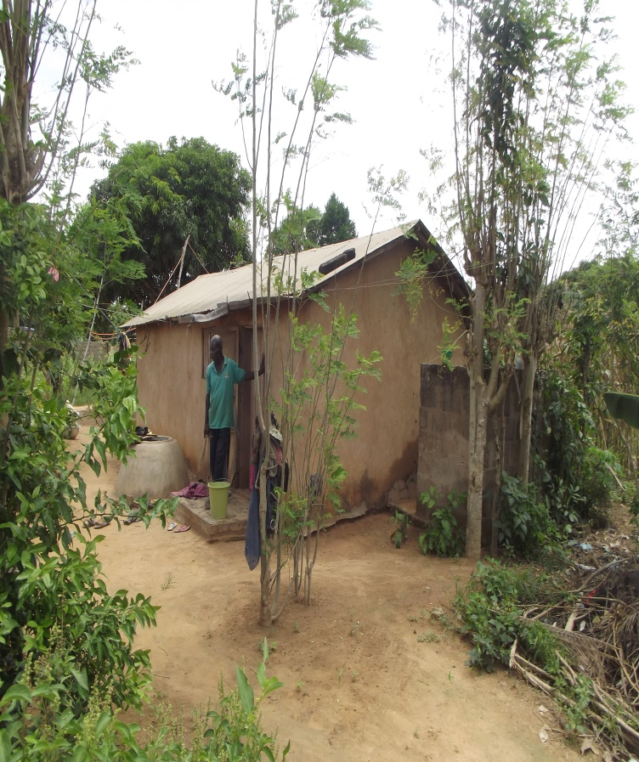
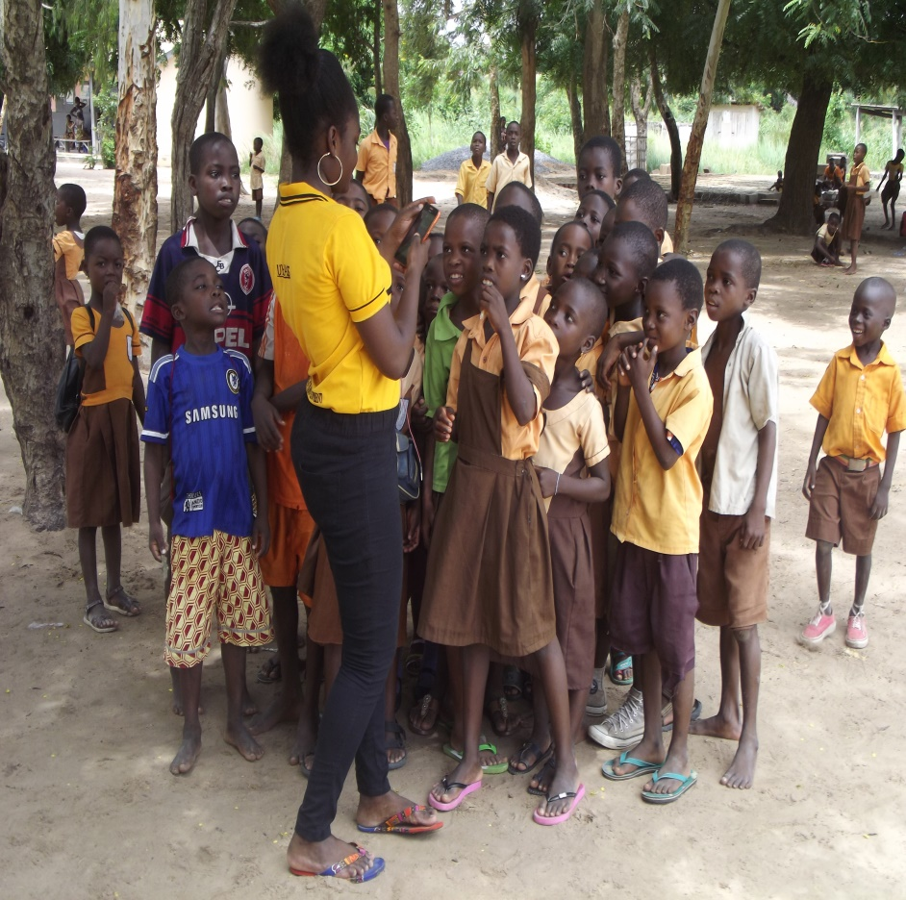
DUTA COMMUNITY
Duta community is located in Aflao in the Volta region of Ghana. It is very close to the Republic of Togo border.
The community is also very close to the diamond cement factory in Aflao.
Inhabitants of these community are mostly peasant farmers.

Slide 5
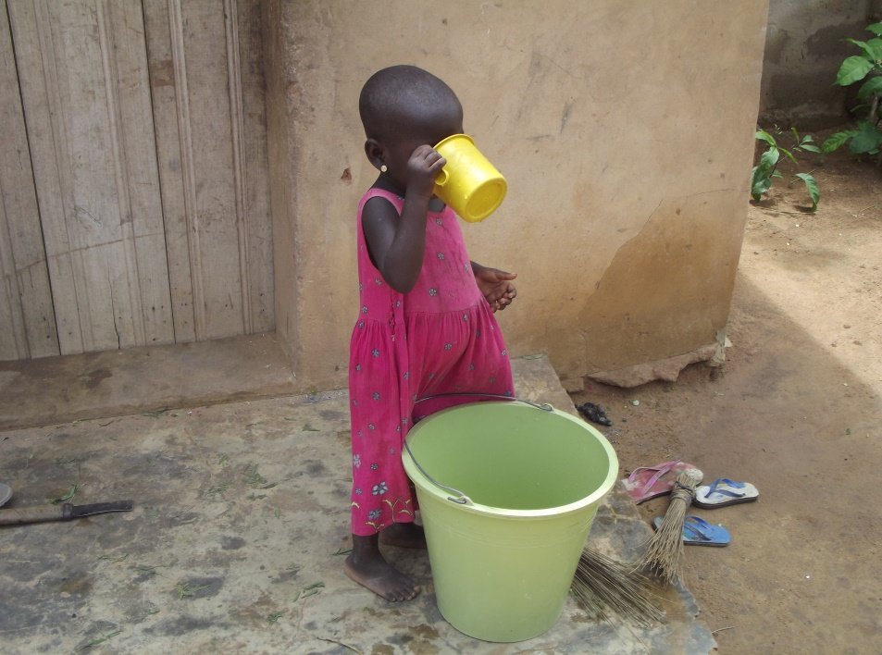
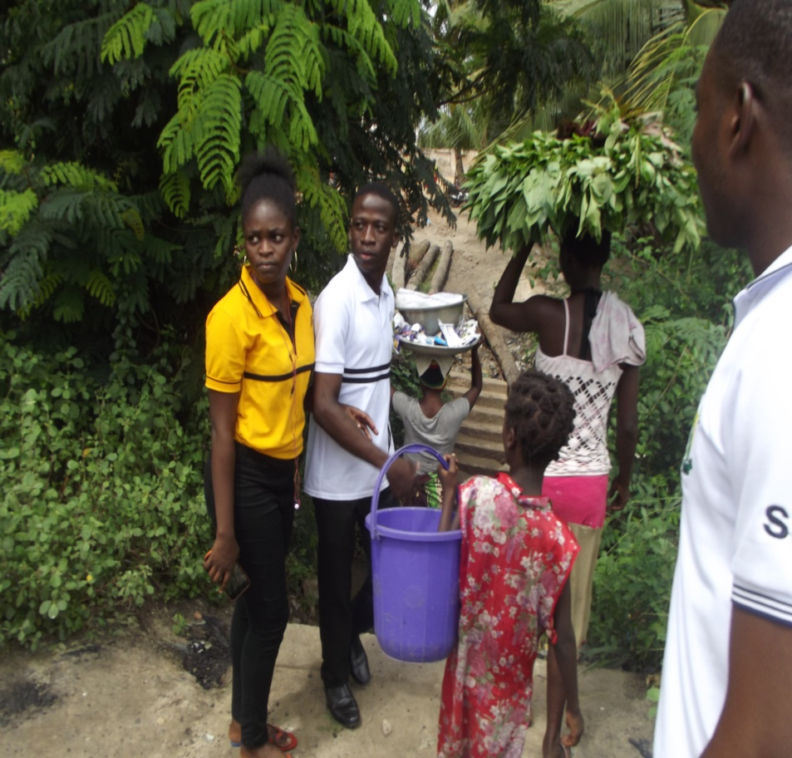
THE PROBLEM
The community is not privileged with pipe-borne water, and the presence of cement dust from the diamond cement factory pollutes both rain water and deep well water which was supposed to be an option for this community.
There is high prevalence of upper respiratory tract infections as well as water-borne diseases.
Residents of this community sometimes have to cross the border to the Republic of Togo to get drinking water.

Slide 6
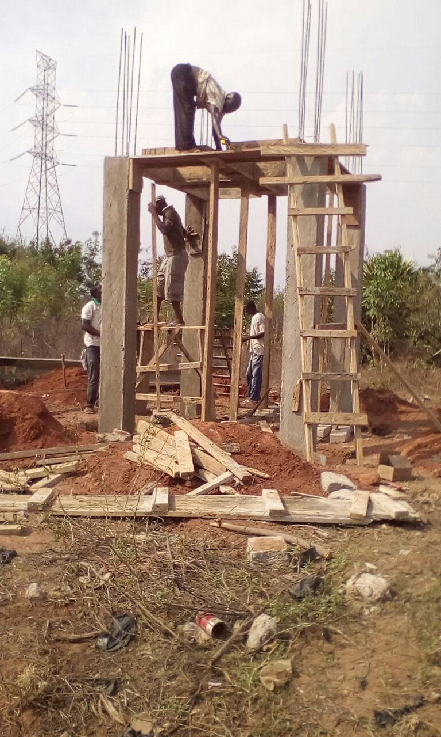
THE SOLUTION
We constructed an ultra modern mechanized borehole with a water tank as a reservoir for easy access by all community members.

Slide 7
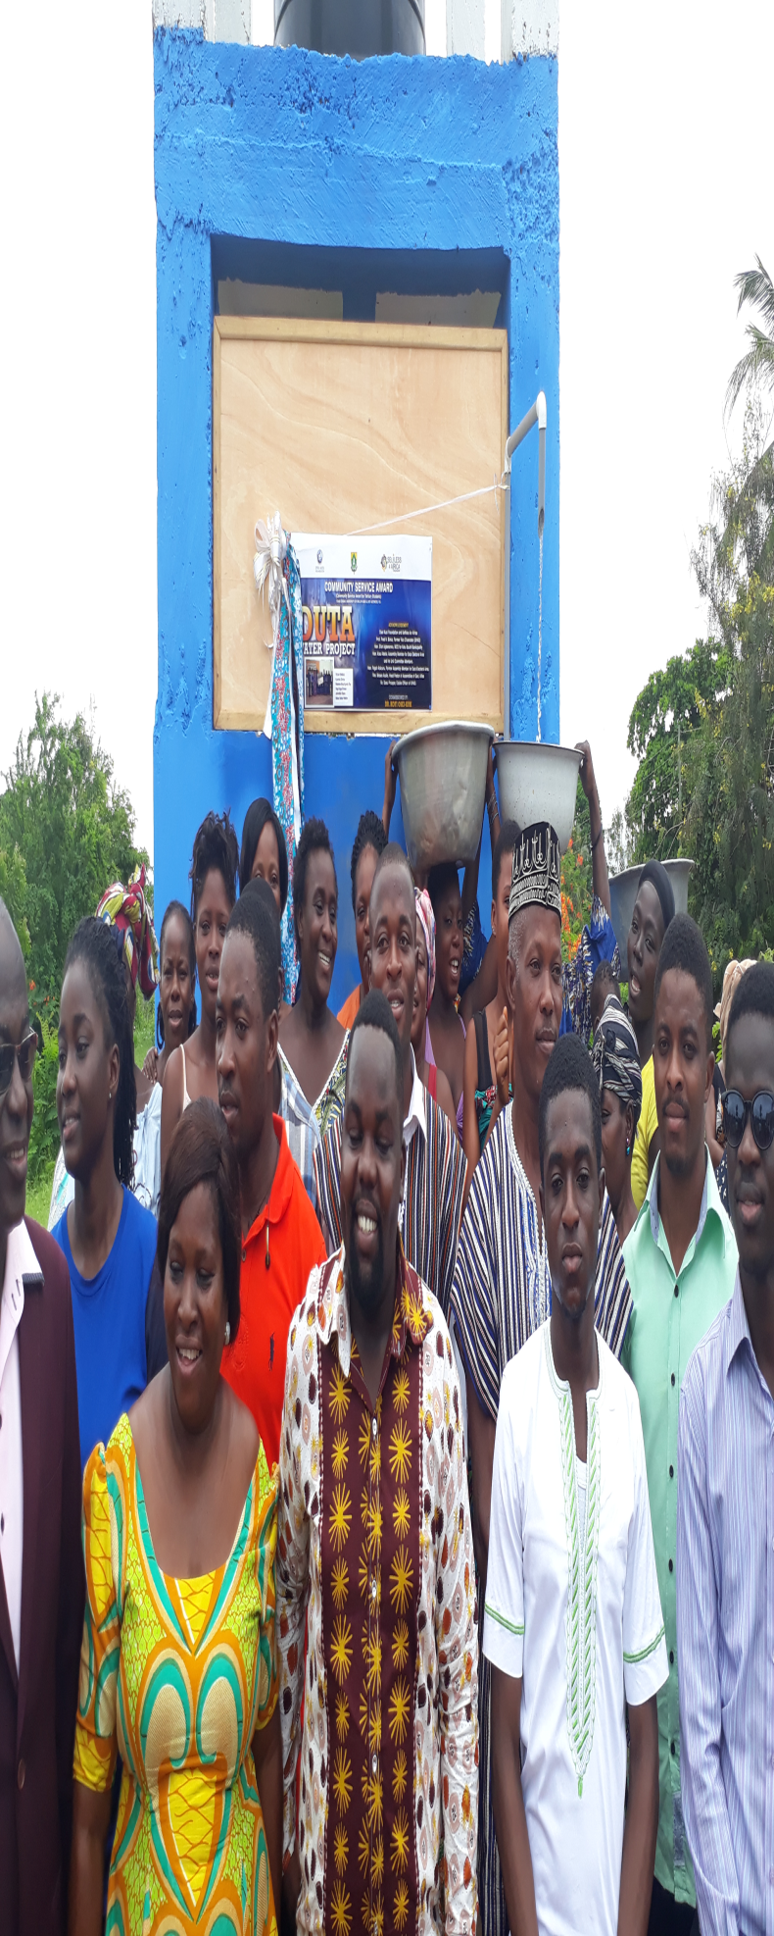
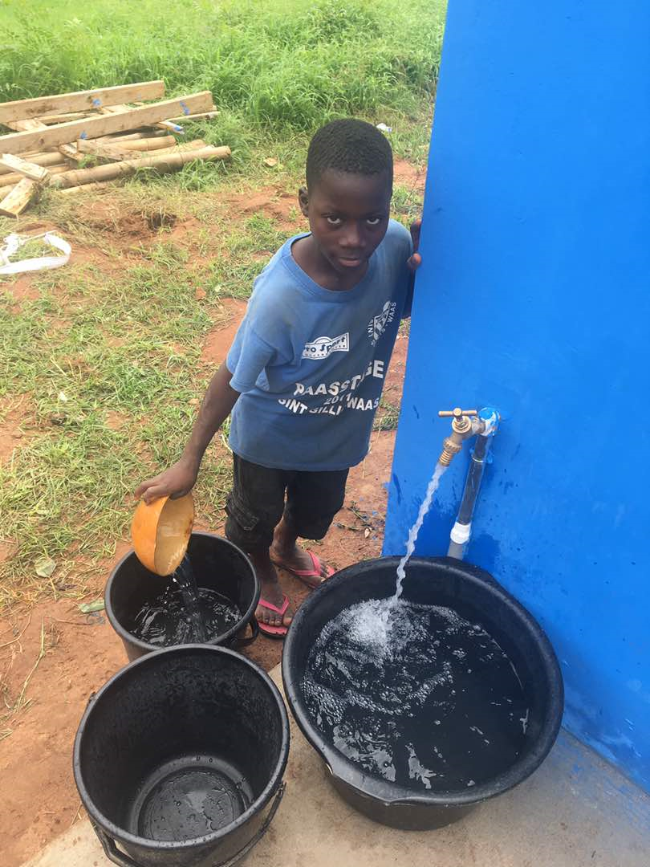
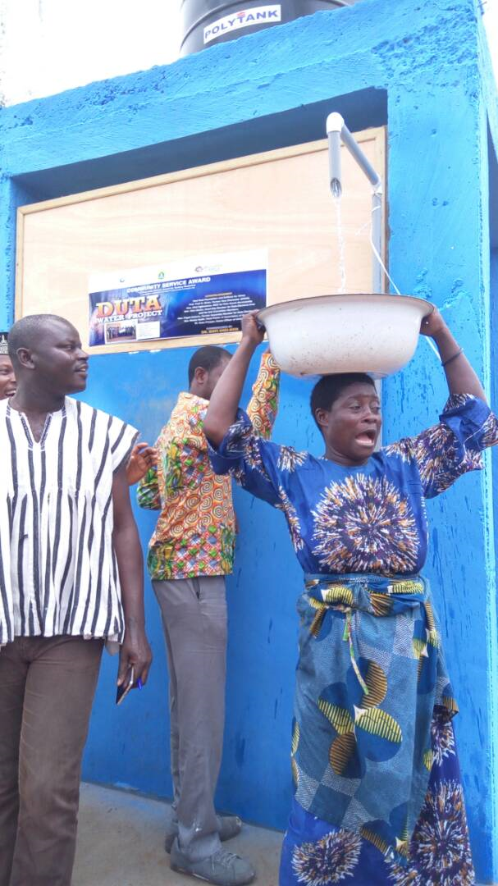

Slide 8
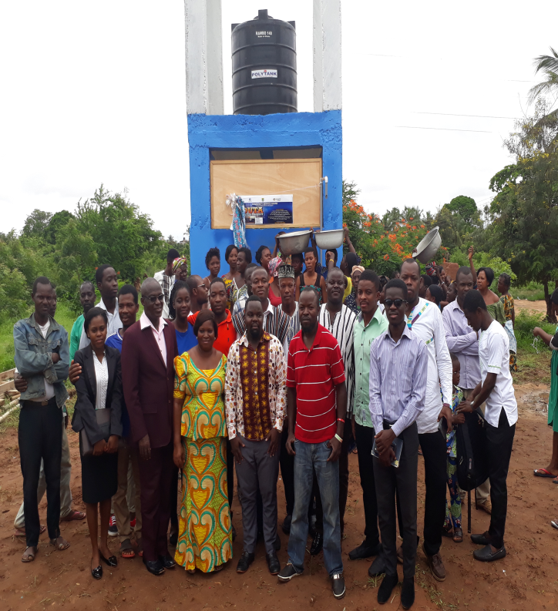
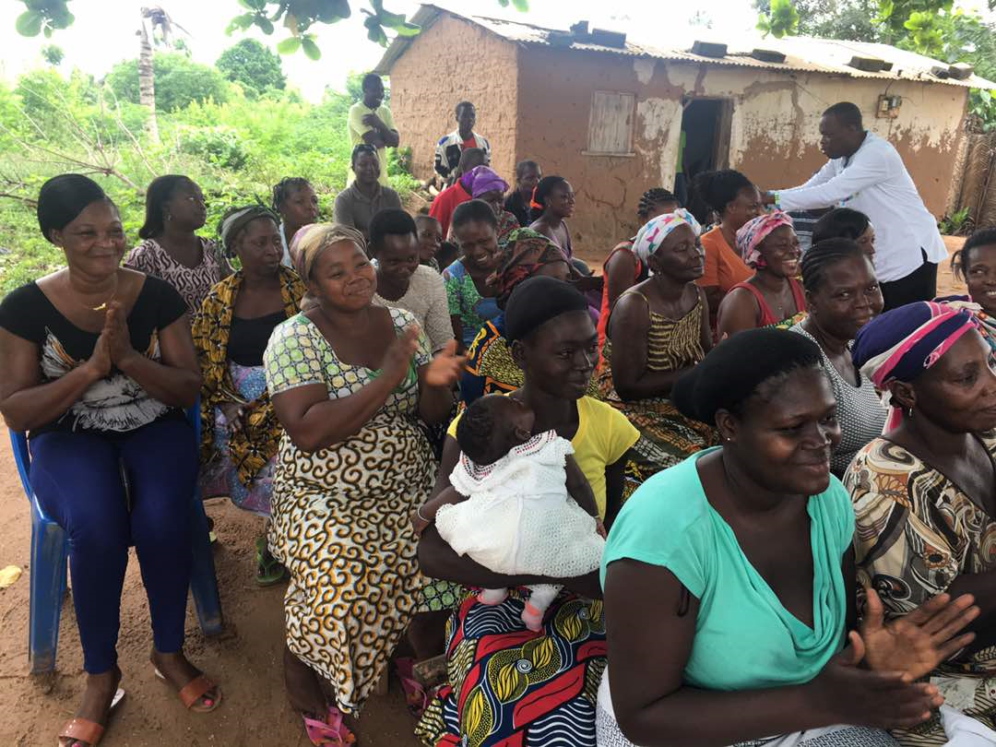

Slide 9
SCHOONHOVEN CURED LEPER VILLAGE: GODOKPE
The village, put up by foreign philanthropists, has a clinic and accommodation for the cured lepers and their dependents in the Volta region of Ghana after the former cured lepers who stayed at the Ho Polyclinic.
“When people come and give us food, there’s a lot. But when the people go, there is nothing to eat.”
“When there is no food, we pray and hope God will direct people to come and give us food.”
- voices of some cured lepers.
While leprosy can be cured with highly effective multidrug treatments, the deformities it can leave behind mean patients often suffer its effects for the rest of their lives, facing hunger, disability, expulsion from families and communities and stigma.

Slide 10
Ho Leprosarium 'ARTS' Project.
‘ARTS', an abbreviation for "A reason to smile", is an initiative of the women's commission of the University of Health And Allied Sciences.
Hansen’s disease (leprosy) is a chronic bacterial infection of the skin and superficial nerves caused by the bacteria mycobacterium leprae.
Unfortunately, there is considerable misunderstanding in the community with many still experience stigma and social rejection.

Slide 11
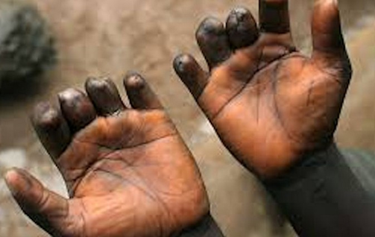
SITUATIONAL ANALYSIS
Sensory loss
Paralysis
Deformities

Slide 12
INTERVENTIONS
Physical assessment of cured lepers to test for Vital signs
Wound dressing
Monitoring drug administration
Health education (infection prevention)
skin sensation
skin sensation.
Donation of food items and clothing
Celebration of birthdays with them
Capacity building (empowerment).

Slide 13
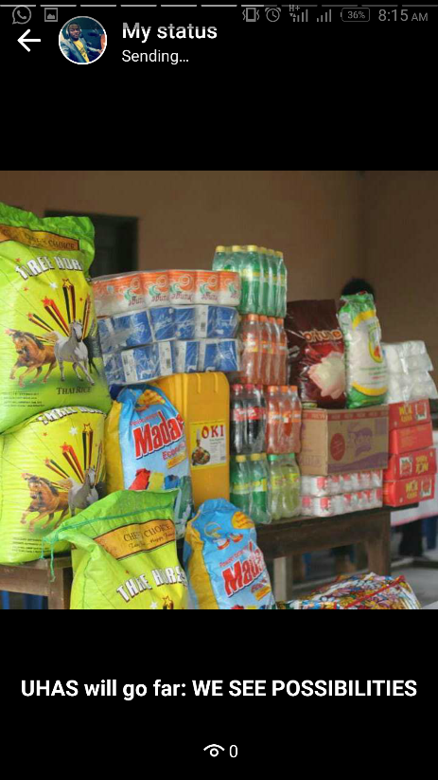
THE TEAM

Slide 14
an insight and reflection OF volunteering
The value of volunteering is much deeper, much more fulfilling, and much more important in contributing to a healthy and vibrant community than money can ever measure.
We volunteered to gain experience, acquire new skills, meet new people or expand our network and simply want to give back to our community to promote health.
Helped us gained work experience (such as teamwork, communication skills, problem-solving, project planning, task management, and organisational skills.)
Gained new experiences and insights (volunteering allows students to get involved with new things and to develop technical, social and academic skills that otherwise might not have been learnt in a classroom environment).

Slide 15
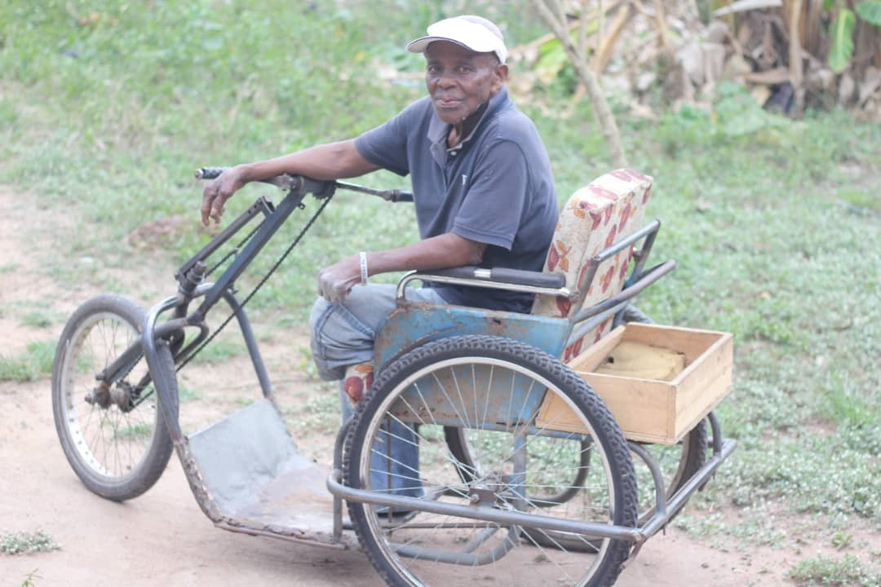
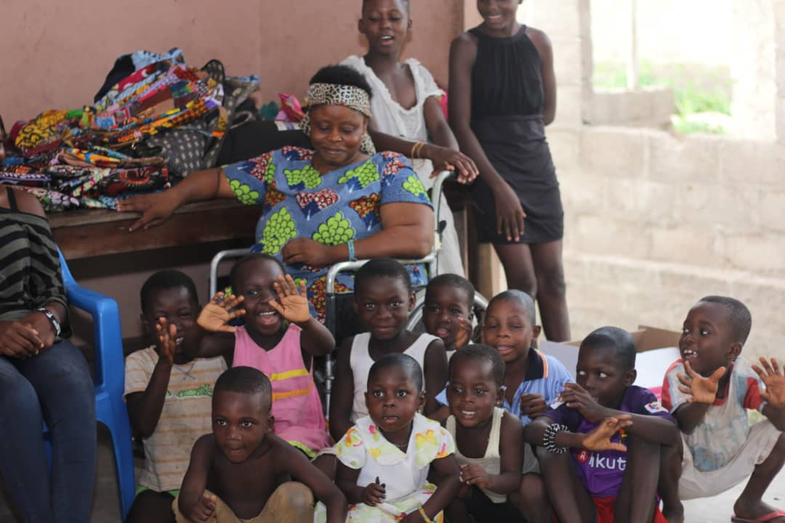
the impact
Volunteering in the leprosarium had a huge impact on our understanding of the needs of structurally vulnerable and disadvantaged groups who experience stigma and social rejection on a daily basis as a result of a chronic health condition.

Slide 16
Overcoming Stigma
Mass Media
Integrated Primary Health Services
Education
&
Training
Government Support (LEAP)
Community Outreach Programs

Slide 17
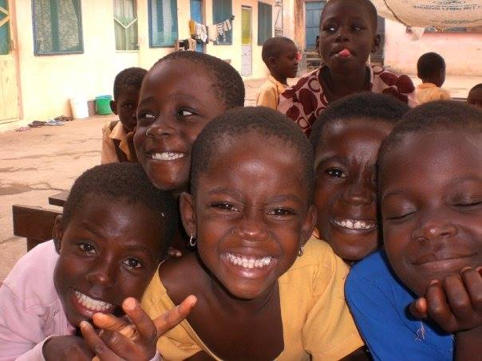
To conclude…..
We are still on the journey of inculcating the spirit of volunteerism among the youth towards community health services.
Our goal is to stop discrimination and promote community inclusiveness
Our communities need us!
They need just a smile.

Slide 18
appreciation
Cured Lepers Foundation
Donor and Schoonhoven Philanthropists
Staff from Ho Polyclinic
University of Health and Allied Sciences
Student volunteers
Mental Health and Wellbeing Foundation
University of Newcastle, Australia.

Slide 19
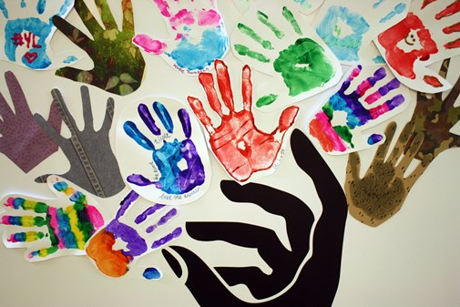
Thank You for Listening

Slide 20
References
Leprosy today (2010). Leprosy: the disease. World health organization. Retrieved from Http://www.who.Int/lep/leprosy/en/index.html on 17/09/2018.
Matsuoka, M. (2010). Drug resistance in leprosy. Japanese journal of infectious diseases 63, no. 1: 1-7. Retrieved from http://www.nih.go.jp.libproxy.lib.unc.edu on 17/09/2018.
National Hansen’s Disease (leprosy) program. Hansen’s disease (leprosy) facts. U.S. Department of Health and Human Services. Retrieved from http://www.hrsa.gov/hansens/ on 17/09/2018.
Sophie, M. (2009). Treatment of leprosy/Hansen's disease in the early 21st century. Dermatologic therapy 22, no. 6: 518-37. Retrieved from http://www3.interscience.wiley.com.libproxy.lib.unc.edu on 17/09/2018.

