Slide 1
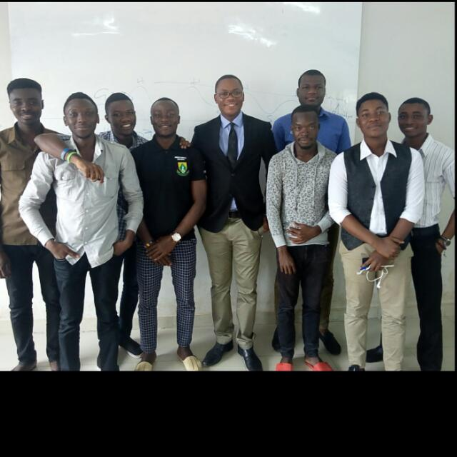
Community Mental Health Promotion: The Exploits of UHAS Students

Slide 2
Presentation Outline
Directors
Background
Objectives of the Program
Activities Carried Out
Conclusion
Acknowledgement

Slide 3
Directors
Michael Lebene¹, (BPH), Kizito Aidam¹, (BPH), Barnabas Atangongo¹, (BPH), James Forson¹, (BPH), Ransford Mensah¹, (BPH), Ahmed Atuahene¹, (BPH), Emmanuel Amekpewu¹, (BPH), Daniel Adisi¹, (BPH) Makam Christopher², (BPH), and Margaret Kweku³, (Prof).
¹Department of Family and Community Health, School of Public Health, University of Health and Allied Sciences, Ho, Ghana.
²Department of Population Health and Behavioral Sciences, School of Public Health, University of Health and Allied Sciences, Ho, Ghana.
³Department of Biostatistics and Epidemiology, School of Public Health, University of Health and Allied Sciences, Ho, Ghana.

Slide 4
Background
In order for an individual to attain the highest form of health it essential to improve one’s mental health.
Mental disorders are responsible for a high degree of burden due to illness making it the reason it is more important.
Owing to this growing burden of mental disorders, it is essential that effective mental health education and promotion measures be taken to reduce the impact of mental disorders on individuals and societies.

Slide 5
Background
Mental health education and promotion often refers to positive mental health, rather than mental ill health.
The education and promotion of mental health therefore is any action taken to maximize mental health and well-being among populations and individuals.

Slide 6
Aims
Our goal was to improve mental health and quality of life,
and to reduce the burden associated with mental disorders in the communities in general.

Slide 7
Activities
Educational programs were organized at;
schools,
prayer camps,
homes,
Out Patient Units,
radio stations, and
on the streets.

Slide 8
Activities
Three basic and junior high schools were visited,
And the only government senior High School in Hohoe was visited

Slide 9
E.P. Junior High School

Slide 10
E.P. Junior High School

Slide 11
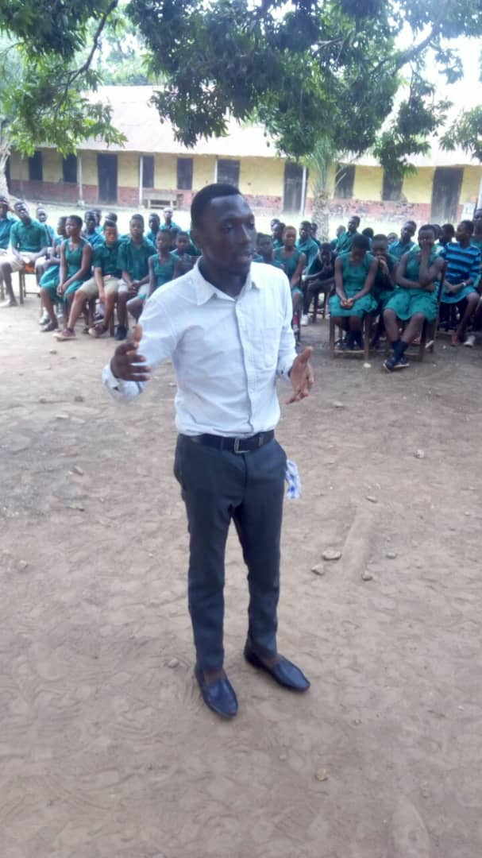
E.P. Junior High School

Slide 12
Holy Rosary Primary School

Slide 13
Holy Rosary Primary School

Slide 14
Holy Rosary Primary School

Slide 15
Activities
There was house to house and street one-on-one mental health promotion in the communities of Hohoe

Slide 16
On the Streets of Hohoe

Slide 17
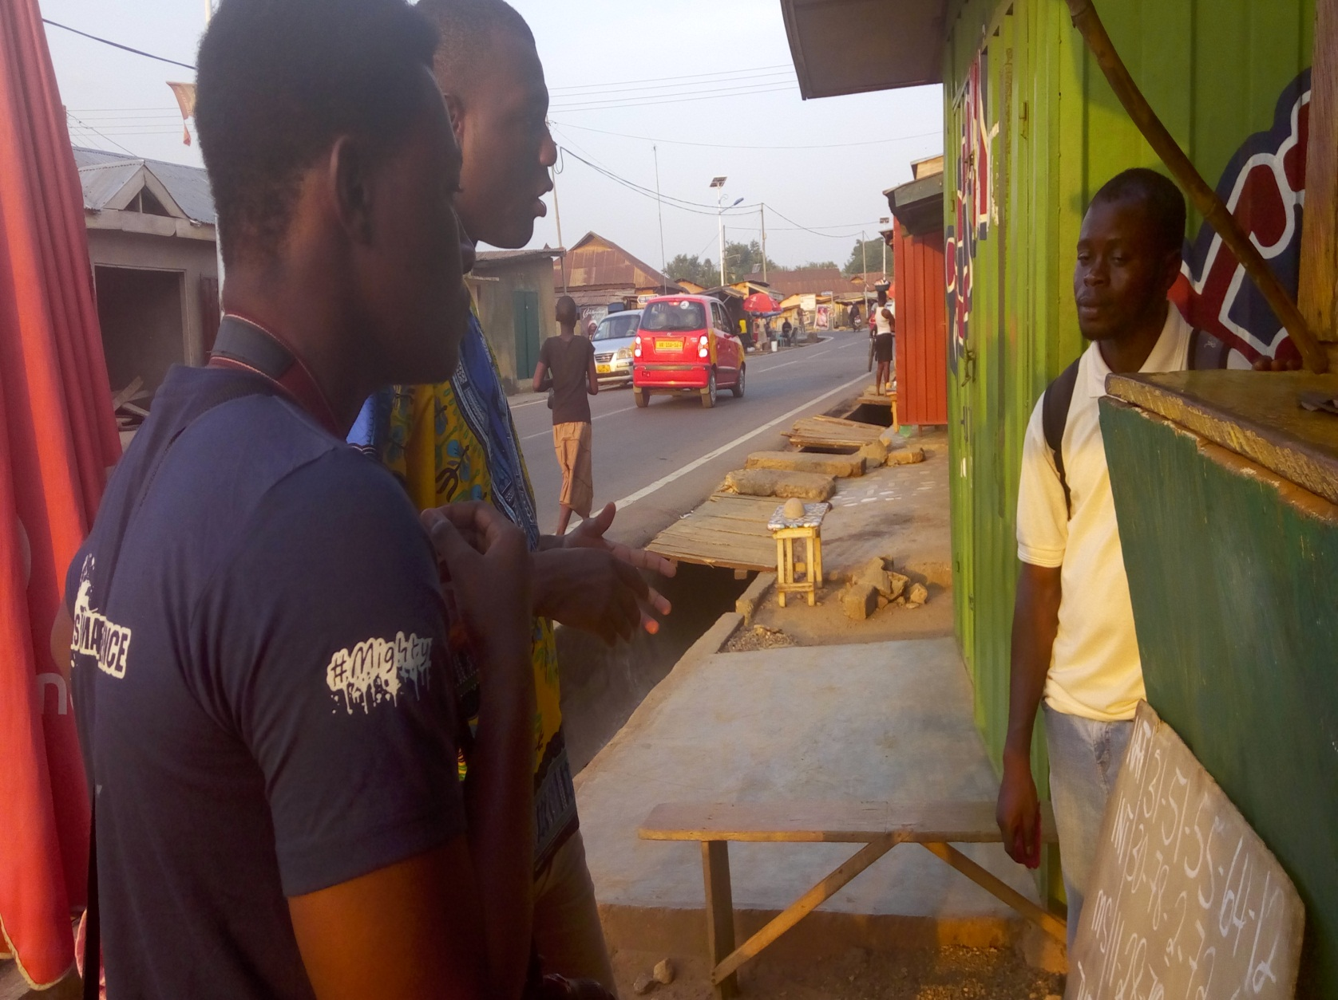
On the Streets of Hohoe

Slide 18
On the Streets of Hohoe

Slide 19
On the Streets of Hohoe

Slide 20
Activities
The Out Patient Departments at the regional hospital in Ho, the Kpando Municipal clinic and the Hohoe Municipal Hospital were reached out to
The Bethel prayer camp at Ho also visited

Slide 21
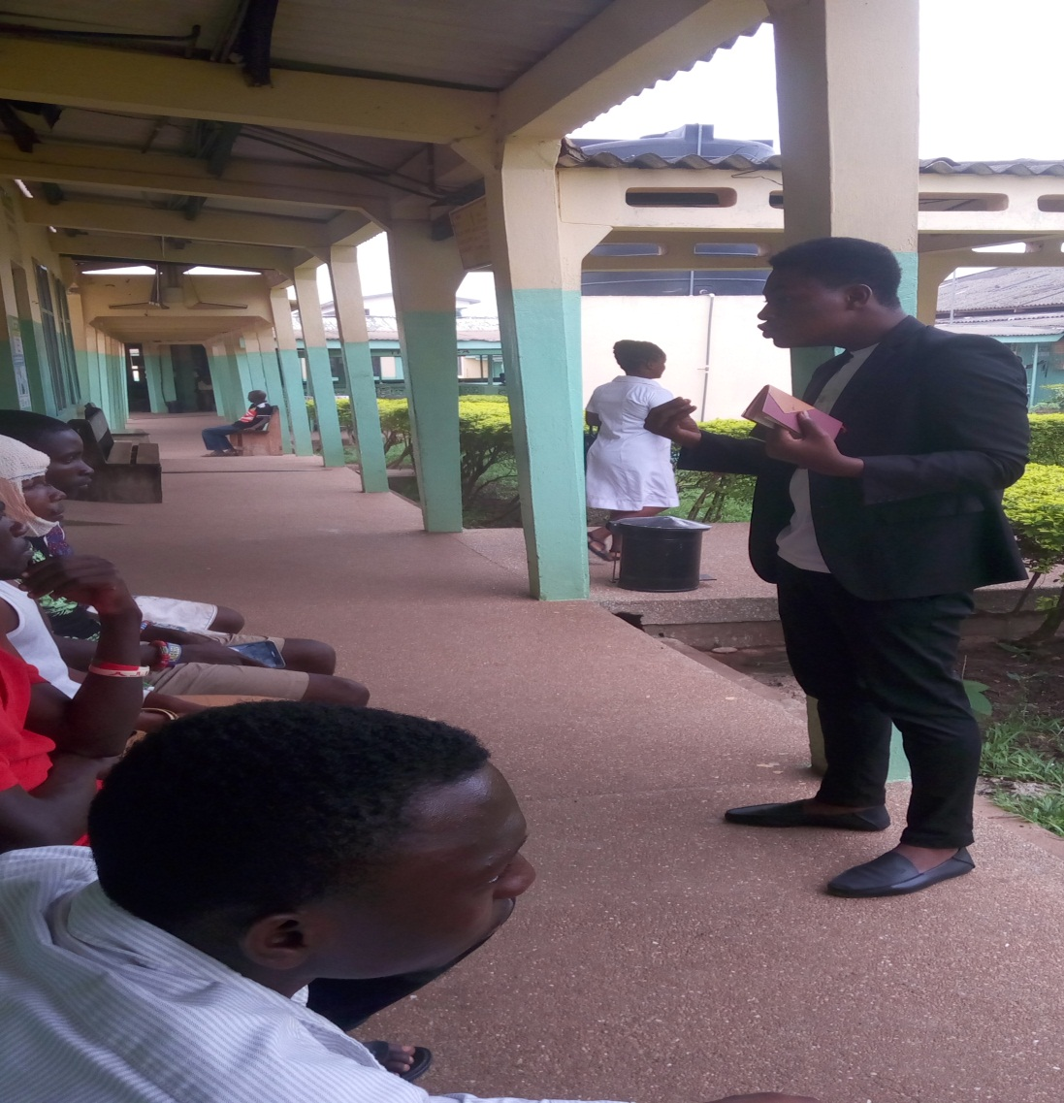
The Out Patient Departments

Slide 22
The Out Patient Departments

Slide 23
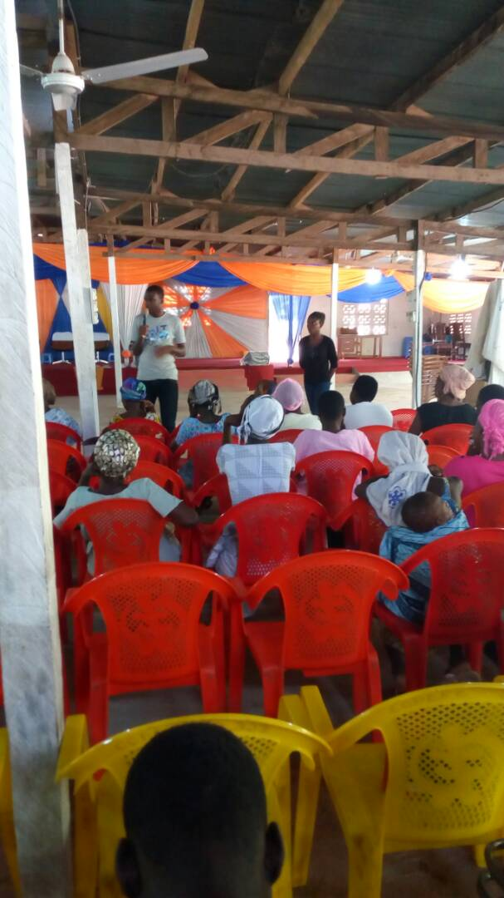
The Bethel prayer camp at Ho

Slide 24
Activities
Two radio stations;
Hogbe FM at Keta and Radio Silver at Sekondi-Takoradi, were also used as media to propagate the awareness of mental health to the communities of Keta and Sekondi-Takoradi

Slide 25
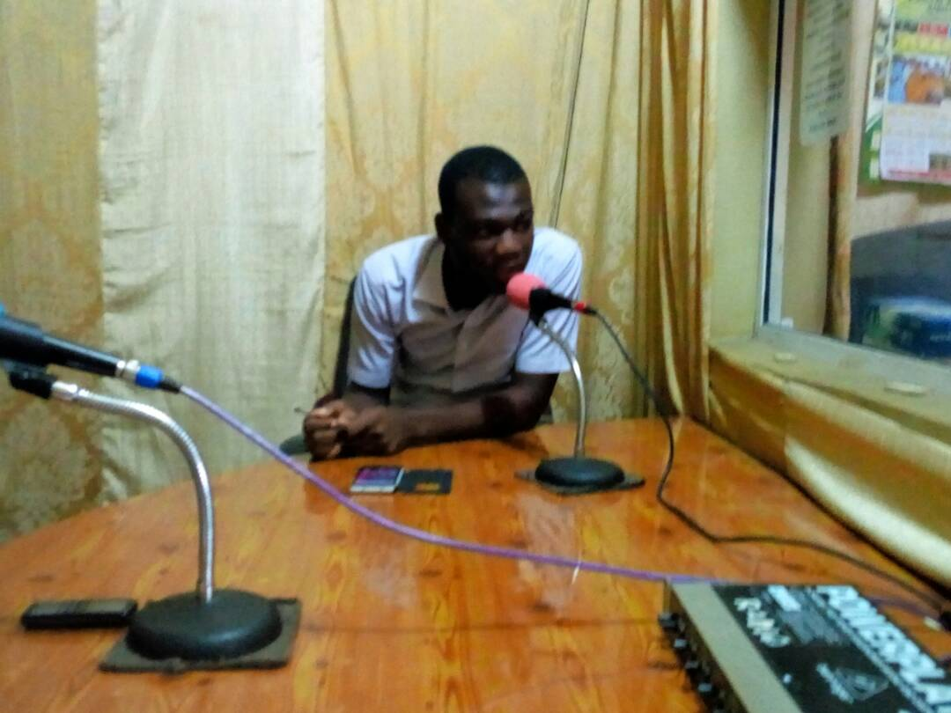
At Hogbe FM

Slide 26
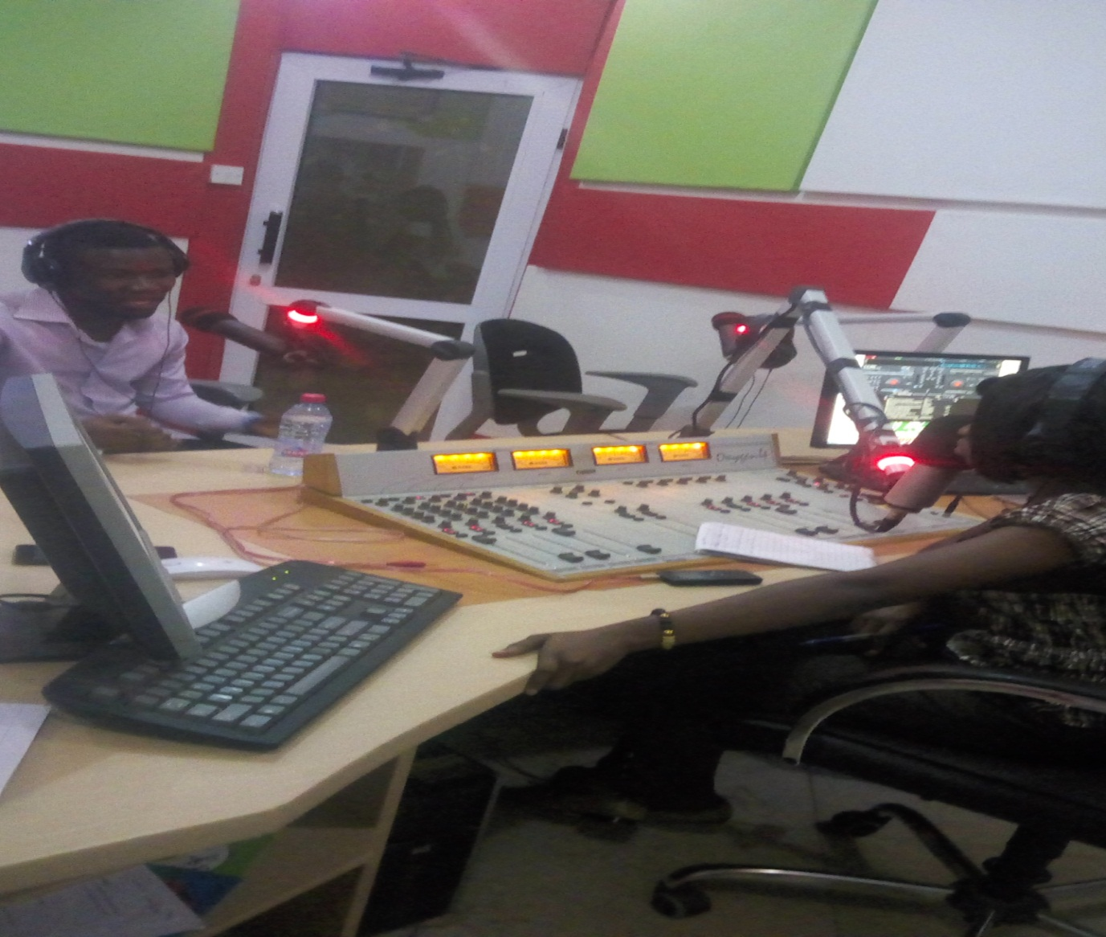
At Radio Silver

Slide 27
Conclusions
All in all, based on the questions we have had to answer and the attention given us at these various places, we infer people’s approaches to their mental health and issues of mental illness will be changed through effective education
However, we have challenges when it comes partnership and funding which infringes greatly on the number of target audience

Slide 28
ACKNOWLEDGEMENT
The Head of ;
Hohoe E.P. Senior High School (HEPSHS)
E.P. Junior High School, Hohoe
Holy Rosary Primary School, Hohoe
Shalom Preparatory School
The Managers of;
Hogbe FM
Radio Silver
The Elder of Bethel Prayer Camp

Slide 29
THANK YOU

Slide 30
QUESTIONS

