Slide 1
Analysis of Service Provision for Mental & Neurological Disorders among Adolescents in two Districts of Ghana
Collaborative research study with Kintampo Health Research Centre, Ghana & Georgetown University, USA
Research Team:
Kenneth AE-NGIBISE, Adrienne FORMENTOS, Solomon NYAME & Kwaku Poku ASANTE

Slide 2
Background
Worldwide, WHO estimates:
350 million people suffer from a depressive disorder,
60 million with bipolar affective disorder,
50 million are living with epilepsy
21 million people with schizophrenia and psychosis,
47.5 million with dementia and
an unknown number likely coping with developmental disorders.
UNICEF (2011) estimates 20% prevalence of mental disorders among adolescents (ages 10-19).
Lifetime prevalence and age of onset for disorders such as mood and anxiety disorders, impulse control and substance abuse disorders (Kessler et al 2014).
50% before age 14
75% before age 24
Notes:
Developmental disorders can include autism and conditions along the autistic spectrum
- Of the 50 million with epilepsy, 80% are considered to be living in LMIC (~40 mil)

Slide 3
Rationale
Developing mental disorders (MD) & neurological disorders early in life is associated with:
poor health outcomes
lower educational attainment
sexual and reproductive issues
increased risk-taking
substance abuse
Increased comorbidities
In Ghana, WHO (2016) estimates 650,000 people are living with a severe mental disorder and 2.1 million coping with a moderate to mild mental disorder.
Prevalence of mental and neurological disorders among the general population nationwide is unknown, including among adolescents
Notes:
Sub-Saharan Africa is a continent that contains the twelve countries with the highest fertility rates, by 2050, a large proportion will be under the age of 25, known as the ‘youth bulge’ (PRB). Needless to say Ghana will need to address mental illness and promote wellbeing among its children and youth now and over the coming decades.
Lack of community screening tools, barriers to access including inability to reach qualified providers, and unknown numbers of persons seeking treatment through traditional healers means it’s very possible cases are not being captured

Slide 4
Mental Health Act, 2012, Act 846.
Established the Mental Health Authority
Tasked with proposing & implementing mental health policies
Promoting mental health & providing treatment & rehabilitation
Promoting care that is culturally appropriate, affordable, accessible and equitably distributed
Integrated care that involved the public & private sectors
Oversee collaboration with traditional medicine & faith healers
Act 846 & its functional implementation has not been evaluated or assessed, especially among the adolescent population
Notes:
Traditional healers were not a targeted group in this study but I did want to acknowledge their recognized presence under the Act
Since 2012, the MH Act has yet to take on any solidified form as policy enactment, program implementation. No additional provisions are specified among children or adolescents.
Direct svc provision not implemented, each district should have a psychiatric unit

Slide 5
Act 846: Section on Vulnerable Populations: Children
Treated in a least restrictive environment.
Upon admission, children should be separated from adults
Parents or guardians of children shall represent them concerning the mental wellbeing of the children including consent to treatment.
Special provision shall be made for the accommodation of children whose conduct may at any time be harmful to them or other patients.
Irreversible treatments such as psychosurgery for mental disorders shall not be administered to children.
The opinions of children shall be taken into consideration in issues of their care.
Notes:
-previous studies have only been in urban settings

Slide 6
Aim
To investigate current state of service provision for adolescents with mental and neurological disorders in Kintampo North and South Districts.
Notes:
Before any true monitoring or evaluation can take place, a situational analysis – or a pulse – needs to be taken to uncover shortfalls or areas that are working well and can be scaled up or replicated. In order to do this, we focused on Kintampo North and South Districts.

Slide 7
Methods - Mixed
Quantitative methods:
Case registers - to estimate prev. of mental & neurological disorders in the population of interest.
Qualitative methods:
Focus Group Discussion &
in-depth interviews (IDI) – find out perspectives
Geographic Information System (GIS):
Mapping of current health facilities combined with the location of mental health services
Notes:
Quantitative Methods used to meet objective #1: documenting CMDs among adolescents
Qualitative Methods used to meet objective #2-5: identifying services, documenting perspectives and challenges, getting perspectives from stakeholders
GIS used to meet objective #6: mapping of current health facilities

Slide 8
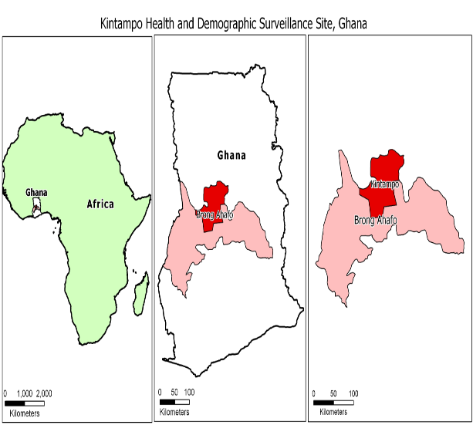
Study Site
Kintampo North Municipal & Kintampo South districts of Brong Ahafo Region.
Population ~ 150,000
Adolescents 24.4% (KHDSS, 2015)
Health Facilities:
two (2) governments hospitals
two (2) private hospitals,
four (4) health centres,
one (1) private clinic,
25 Community-based Health Planning Services (CHPS) areas
two (2) maternity homes.
Notes:
These two districts are two contiguous districts as well as they lie in the geographical centre of Ghana.
- Predominantly rural

Slide 9
Mental Health Structure for Kintampo North & Kintampo South, Brong Ahafo
Region Level:
Includes 27 municipalities/districts
Direct Service Providers
Functions & Funding
Brong Ahafo
Municipality/District Level
Kintampo Municipal North
Kintampo South
Municipal Hospital
Outpatient Unit
Municipal Unit for Mental Health Services
College of Health Kintampo
Psychosocial Center
District Hospital
Community Psychiatric Unit
Notes:
Municipal hospital → OPD unit
Health directorate → municipal unit
COHK→ psychosocial center
The providers all have outpatient services, but are differentiated by sources of funding and the number of personnel

Slide 10
Study Population & Sample Size
Providers – 7
Stakeholders - 10
Mental Health Users - 14
Clinical Psychologist
Community Psychiatric Officer (CPO)
Community Mental Health Officer (CMHO)
Community Psychiatric Nurse (CPN)
Registered Mental Health Nurses (RMN)
Mental Health Service Providers
Notes:
Main arena of interest was getting perceptions of direct service providers as they are the front line of MH service provision
Stakeholders: MHA rep, 2 NHI (North and South), 2 SHEP (North and South), 2 School Counselors (North and South) Patient respondents include patients and caregivers.

Slide 11
Data Collection – Participants
 | Regional Level | Kintapo North | Kintampo South
Direct Service Provider |  | 1 Clinical Psychologist
 |  | 1 CMHO | 1 CMHO
 |  | 2 CPNs
 |  | 1 CPO
Stakeholder | 1 MHA representative | 1 NHI PR Officer | 1 NHI PR Officer & 1 NHI Manager
 |  | 1 Social Worker | 1 Social Worker
 |  | 1 SHEP Coordinator | 1 SHEP Coordinator
 |  | 1 School Counselor | 1 Special Education Coordinator
Adolescent Users |  | 3 adolescent users
Caregivers |  | 10 caregivers + 1 adult user
In all, 17 IDIs & 1 FGD
Notes:
Total IDIs: 15. H – 6 providers (5 North, 1 South), 10 stakeholders (along the way, providers mentioned a working relationship with the department of social work and so we were able to interview additional stakeholders)
Scheduled independent meetings with direct service providers either at work site or invited them to other private space. Consent was explained verbally in English; consent forms were signed and collected by the study team. All interviews were recorded using two (2) electronic recorders. Each interview was transcribed into English on Microsoft Word.

Slide 12
Data Analysis
Assessment Tool: Saya, WHO & UNAIDS quality standards & indicators
STATA 14 used to identify frequency and percentage of mental & neurological disorders as diagnosed by direct service providers
MAXQDA used to identify themes of quality of adolescent services
Adapted tool from Sayal et al 2012
WHO & UNAIDS

Slide 13
Data Analysis – Combined quality standards & indicators
Practice Level
Consultation Factors
Health Visitors
Further Services
Community Support
Appropriate Package of Services
Providers Competencies
Facility Characteristics
Data and Quality Improvement
Confidentiality
Knowledge
Attitude
Access
Community Partnerships
Diagnosis
Training for Adolescent-specific care
Operational Hours
Data Collection
Awareness
Treatment
Data Analysis
Continuity of Care
Referral
Adolescent-specific space
Communication
Counselling
Service utilization
Notes:
20 quality standards and 23 quality indicators; after one round of coding, other themes emerged

Slide 14
Distribution of commonly treated mental disorders among adolescents in 2015 in Kintampo North area - Ghana
Combined Diagnoses | Total | Female (N%) | Male(N%)
Epilepsy | 193 | 87 (68.0) | 106 (57.5)
Enuresis | 39 | 17 (13.3) | 22 (14.0)
Anxiety | 19 | 11 (8.6) | 8 (5.1)
Psychosis | 11 | 2 (1.6) | 9 (5.7)
Migraine | 7 | 3 (2.3) | 4 (2.5)
Seizure unspecified | 7 | 5 (3.9) | 2 (1.3)
Enuresis Nocturnal | 2 | 0 (0.0) | 2 (1.3)
Schizoaffective Disorder | 3 | 1 (0.8) | 2 (1.3)
Substance Abuse | 2 | 1 (0.8) | 1 (0.6)
Bipolar disorder | 1 | 1 (0.8) | 0 (0.0)
ADHD | 1 | 0 (0.0) | 1 (0.6)
Other | 285 | 128 (100) | 157 (100)

Slide 15
Qualitative Results
Notes:
FGD – caregiver pressing thumb into ink pad to sign consent form. All of the women in this FGD were illiterate.

Slide 16
Results
Community sensitization was a way to create awareness of programs and services available by providers & by stakeholders.
“If there’s like the chiefs, if they identify somebody in the community as having a mental challenge, the assembly man will just link up with us.” – NHIS Representative, KN
Community Sensitization
“The teachings that they are providing for us is adequate because they have given the training such that even within our neighborhood if something similar should occur we [are] able to advise them on what to do.” –Caregiver, Male
Notes:
NHIS rep- stressed importance of community buy-in, building rapport and strengthing relationships with clients, future clients
Caregivers’ education from counseling and communication made them feel equipped to handle patients’ illnesses and also become advocates

Slide 17
Results
Providers were asked about diagnostic services, medication or other prescribed treatments, & counseling, and if they felt the services available were adequate.
“We lack so many diagnostic tools so sometimes we look at the signs & symptoms & give a provisional diagnosis and then we treat.” – CPN, KN
Appropriate Package of Services
“Well, taking a proper history of a client… is one of the best way[s] of getting your diagnosis. You know for sure something like epilepsy, which is very common among my clients. It take[s], seeing the person, & the way the person even presents himself. You get that actually it’s epilepsy.” – CMHO, KS
Notes:
In practice, no providers specified the use of any diagnostic tools or questionnaires for mental illnesses. Two providers did mention the use and necessity of referring to other health professionals for second opinions but this was not a standard practice for providers who worked primarily in the community, such as the CMHOs. Only one provider stated it was standard practice to have patients complete blood tests to rule out alternative causes of specific disorders.

Slide 18
Results
Providers reported that lack of medications was a difficulty in providing adequate treatment
“Sometimes we had inadequate supply of psychotropic [drugs]…& for some time our patients are suffering, so we are going to get supplies.” – Clinical Psychologist, KN
Appropriate Package of Services
Caregivers and patients considered access to medication to be adequate as long as there was a supply
“I am happy with the kind of service that they provide here. They have made us understand that their medication reacts slowly. They also told us to exercise patience when the start reacting towards the medication. I think that he has received all the help that he is supposed to get here.” – Male, Caregiver

Slide 19
Results
Providers viewed counseling as inclusive of caregivers in the patient’s recovery
“We do counseling. Apart from giving the medication you counsel the person on the condition, and then the caregiver, you try to talk to them too.” - CMHO, Kintampo South
Appropriate Package of Services
Caregivers reported counseling services were adequate. One patient reported poor communication with his provider.
“The medication that they gave me that I did not see any improvement in my condition was not changed. I was hoping that they will change that medication for me but it did not happen.”
When the patient was asked if he has ever reported this to his care team, he replied, “No, I did not say anything to them.” –Adolescent user, Male, 14
Notes:
Providers viewed counseling as all-inclusive and focused on education, advocacy, and family counseling. One provider mentioned loss to follow up as a challenge in providing counseling services.
Quote: “We do counseling. Apart from giving the medication you counsel the person on the condition, and then the caregiver, you try to talk to them too..[she further went onto say] If you explain to [caregivers], they will begin to understand that it’s not intentional, or it’s not because they don’t respect, but it’s a condition that we are trying to manage.” - CMHO, Kintampo South
Caregivers reported counseling services were adequate as they felt included in the process of recovery of relatives. One adolescent patient reported dissatisfaction with his care.

Slide 20
Results
Providers & stakeholders were asked about data collection, analysis, & service utilization
Each facility had a varied method of data collection as there was no standardized method of keeping records.
Data Management
“We barely had a computer when we started so everything was stored in folders & even the store room where we kept our folders and other information relating to patients is currently inadequate.” – Clinical Psychologist, KN
Stakeholders also were tasked with compiling monthly reports but did not complete any analysis on service utilization.
Notes:
Providers and stakeholders were asked about case registers, reports, data collection, any analysis of the data, and increases or decreases in service utilization by any of their patients and clients.
Stakeholders section: An ongoing school program funded by an external NGO required monthly data but analysis of that data was never returned to the GES stakeholders.
Data management. All providers and stakeholders mentioned collected data and sending it to their directorate, regional or national HQ.
None of the providers did data analysis
There was no evidence-based way to track service utilization.

Slide 21
Results
Providers & stakeholders were finally asked about challenges. The most common challenges that arose were stigma, transportation logistics, funding & medication procurement.
Shortage of psychotropic drugs led to providers’ temporary solution of accepting “tokens” (copays) for treatment.
Challenges: Medication Procurement
“We make the clients contribute a token & we also support them in any way that they can, so that they can continuously get access to their medications and sometimes too we get few support from health directorate… There [are] no funds. Medications are scarce, so how do you go for outreach? We are already risking what we are doing, we are not supposed to take money from the clients towards their services but if we don’t do it, they are at risk.” – CPN, KN
Notes:
For the sake of time, I am only going to talk in-depth about medication procurement. All providers reported a shortage of monthly medications was a challenge to ensuring patients adhered to treatment and did not relapse. Providers came up with the use of “tokens”.
This is a practice that deters patients and caregivers from seeking treatment, knowing they will be responsible for these drugs every month.

Slide 22
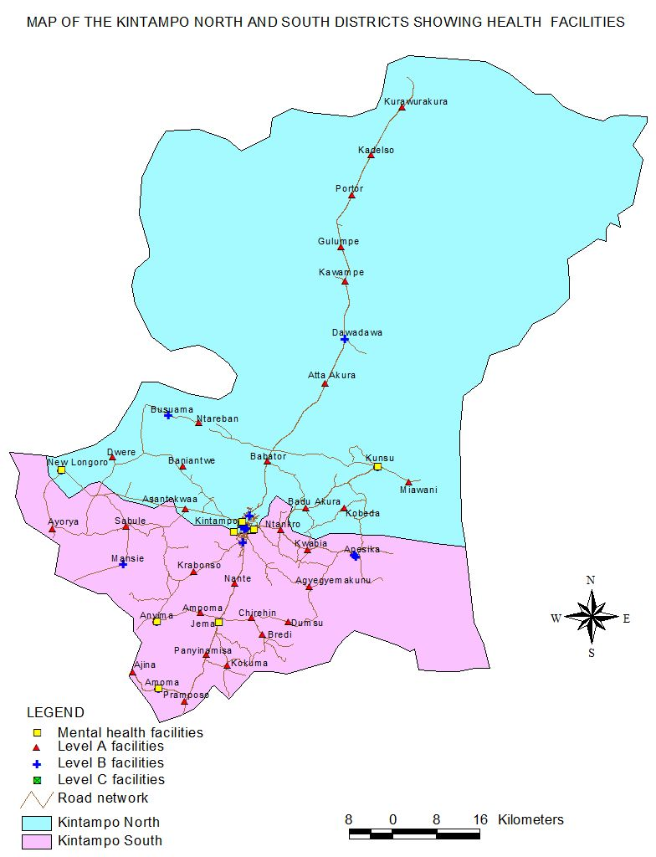
Geographic Information System
Notes:
14 Level A facilities – North
15 Level A facilities – South
8 Level B facilities – combined
Level C – unable to see
Mental health facilities – 8
CHPS – clinics that provide care, referral

Slide 23
Recommendations
Better data management and improved record keeping
Document best practices like advocacy and sensitization
Increase cooperation with other health providers who offer similar services and with non-health providers
Proper tools and education for diagnosing disorders accurately will improve patient safety
More quantitative evidence and data is needed to illustrate the whole picture on this region and similar states
Notes:
Recommendation on data management – improve record keeping at facility level through the use of a computer database system that is accessible to providers and data entry specialists (training recommended on appropriate information to capture like sociodemographic information, and which fields to populate). Recommend reports generated every month and possibly quarterly MH service providers could meet at one location to discuss best practices.
- Use of client intake forms and medical history could assist in identifying differential diagnoses (e.g., patient experienced past head trauma, patient in infancy experienced fever or other sickness)
Cooperation and collaboration between medical providers would also for smooth transition for users who possibly migrate geographically or for personal reasons decide to seek services elsewhere. MOUs among health and non-health providers

Slide 24
Conclusion
There are few mental health service providers for people living with mental and neurological disorders in the two Kintampo districts, with no specific services for adolescents.
Passage of the Mental Health Act 846 is an important milestone in mental health care but currently no specific plans for adolescent mental health in the two Kintampo districts.
Community sensitization and advocacy against stigma are all successful programmes that need to be adopted.
Notes:
It’s an unspoken fact that mental health and neurological disorders are hidden and not prioritized but there is plenty of data out there that show funding must be increased to care for these people in the population.
Epilepsy is not a mental disorder. This may be a apple v. pear difference but ultimately, providers who are trained in mental health are caring for illnesses beyond their scope. This is unsafe especially for children who may be experiencing unprovoked seizures for reasons outside of epilepsy.

Slide 25
Thank you for your audience

Slide 26
References
Kessler RC, Berglund P, Demler O, Jin R, Merikangas KR, Walters EE. (2005.) Lifetime Prevalence and Age-of-Onset Distributions of DSM-IV Disorders in the National Comorbidity Survey Replication. Arch Gen Psychiatry. 62(6):593-602
Naik, U. (2015.) Magnitude of Mental Health Problems in Adolescence. In Mehta, M. & Sagar, R. (Eds.), A Practical Approach to Cognitive Behavior Therapy for Adolescents. India: Springer.
Patel, V., & Stein, D. (2015). Common mental disorders in Sub-Saharan Africa: The Triad of Depression, Anxiety, and Somatization. In Akyeampong E., Hill A., & Kleinman A. (Eds.), The Culture of Mental Illness and Psychiatric Practice in Africa (pp. 50-72). Indiana University Press.
Population Reference Bureau (PRB). (2015). 2015 World Population Data Sheet. http://www.prb.org/pdf15/2015-world-population-data-sheet_eng.pdf.
Sayal, K., Amarasinghe, M., Robotham, S., Coope, C., Ashworth, M., Day, C., … Simonoff, E. (2012). Quality standards for child and adolescent mental health in primary care. BMC Family Practice, 13(1), 1–8. http://doi.org/10.1186/1471-2296-13-51
World Health Organization. (WHO). (2016a). Mental disorders. Fact Sheet. http://www.who.int/mediacentre/factsheets/fs396/en/
WHO. (2016b). Adolescents: health risks and solutions. Fact Sheet. http://www.who.int/mediacentre/factsheets/fs345/en/.
WHO. (2016c). Ghana: Situational Analysis. Mental Health. http://www.who.int/mental_health/policy/country/ghana/en/.
WHO and UNAIDS. (2015.) Volume 1: Standards and Criteria. Global Standards for Quality Health-Care Services for Adolescents: A Guide to Implement Standards-Driven Approach to Improve the Quality of Health-Care Services for Adolescents. Switzerland: World Health Organization.
WHO and UNAIDS. (2015.) Volume 3: Tools to conduct quality and coverage measurement surveys to collect data about compliance with the global standards. Global Standards for Quality Health-Care Services for Adolescents: A Guide to Implement Standards-Driven Approach to Improve the Quality of Health-Care Services for Adolescents. Switzerland: World Health Organization
WHO. (2005.) Child and Adolescent Mental Health Policies and Plans. Mental Health Policy and Service Guidance Package. http://www.who.int/mental_health/policy/services/9_child%20ado_WEB_07.pdf

