Slide 1
4TH INTERNATIONAL CONFERENCE, 2018
theme
MENTAL WELL-BEIGN OF OUR YOUTH AND YOUNG ADULTS

Slide 2
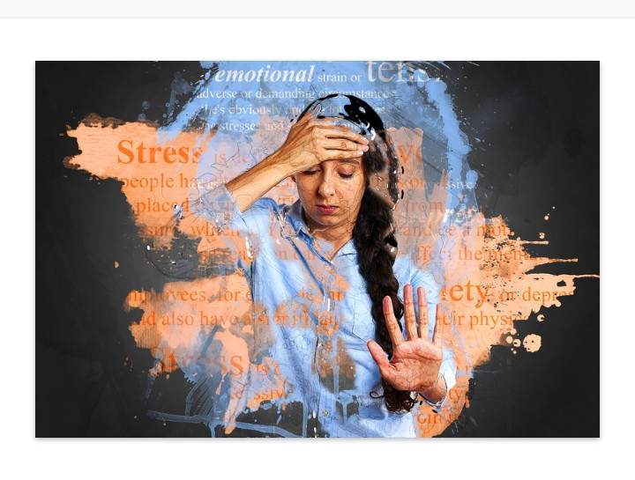

TITLE
DEPRESSION, ANXIETY AND STRESS ON QUALITY OF LIFE OF ADOLESCENTS

Slide 3
Authors
Ahmed ATUAHENE, BPH (Mental Health)
&
2. Bright AKPALU, BA(Hon), Mphil. Clinical Psychology

Slide 4
Presentation Outline
Background
Objectives
Methodology
Results
Conclusion and Recommendations

Slide 5
Background
This study assessed depression, anxiety and stress symptoms in adolescent and their effects on quality of life. The study was carried out in the Kwabre East District in the Ashanti region of Ghana among three senior high schools; SIMSS, Kofi Agyei Senior High School and Our Ladies of Grace Senior High School.

Slide 6
Objectives
The main objective of the study was to assess depression, anxiety and stress symptoms in adolescents and their effects on quality of life; determined the severity of these disorders, some risk factors, and established correlations of these disorders on quality of life.

Slide 7
Methodology
A cross sectional study was employed to conduct the study with 390 students from three public senior high schools by simple random sampling. After students had consented to participate, three sets of questionnaires were administered: demographic data, Rosenberg Self-esteem Scale and the Depression, Anxiety and Stress Scale (DASS 21). SPSS was used to draw percentages and establishing correlations.

Slide 8
Results

Slide 9
1.0 Level of stress
 | Frequency | Percentage (%)
Normal | 182 | 47
Mild | 64 | 16
Moderate | 79 | 20
Severe | 57 | 15
Extremely severe | 8 | 2
 | [N] =390 | 100

Slide 10
1.1 Level of anxiety
 | Frequency | Percentage (%)
Normal | 91 | 23
Mild | 23 | 6
Moderate | 98 | 25
Severe | 57 | 15
Extremely severe | 121 | 31
 | [N]=390 | 100

Slide 11
1.2 Level of depression
 | Frequency | Percentage (%)
Normal | 118 | 30
Mild | 74 | 19
Moderate | 122 | 31
Severe | 42 | 11
Extremely severe | 34 | 9
 | [N]=390 | 100

Slide 12
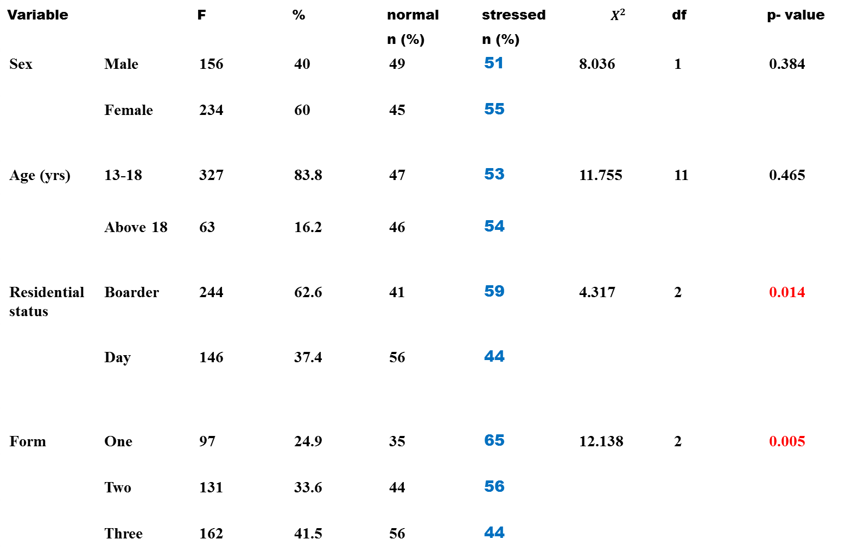
2.0 Demographics and stress
Variable |  | F | % | normal n (%) | stressed n (%) | $$X^{2}$$ | df | p- value
Sex | Male | 156 | 40 | 49 | 51 | 8.036 | 1 | 0.384
 | Female | 234 | 60 | 45 | 55
Age (yrs) | 13-18 | 327 | 83.8 | 47 | 53 | 11.755 | 11 | 0.465
 | Above 18 | 63 | 16.2 | 46 | 54
Residential status | Boarder | 244 | 62.6 | 41 | 59 | 4.317 | 2 | 0.014
 | Day | 146 | 37.4 | 56 | 44
Form | One | 97 | 24.9 | 35 | 65 | 12.138 | 2 | 0.005
 | Two | 131 | 33.6 | 44 | 56
 | Three | 162 | 41.5 | 56 | 44

Slide 13
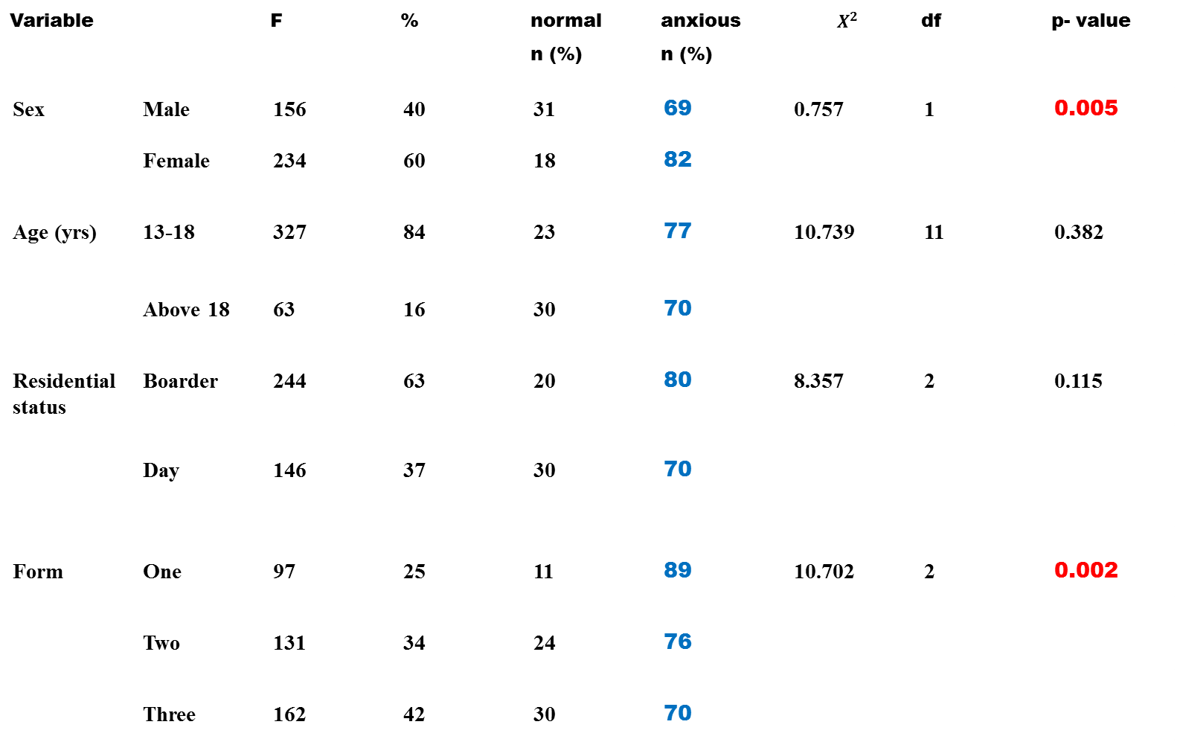
2.1 Demographics and anxiety
Variable |  | F | % | normal n (%) | anxious n (%) | $$X^{2}$$ | df | p- value
Sex | Male | 156 | 40 | 31 | 69 | 0.757 | 1 | 0.005
 | Female | 234 | 60 | 18 | 82
Age (yrs) | 13-18 | 327 | 84 | 23 | 77 | 10.739 | 11 | 0.382
 | Above 18 | 63 | 16 | 30 | 70
Residential status | Boarder | 244 | 63 | 20 | 80 | 8.357 | 2 | 0.115
 | Day | 146 | 37 | 30 | 70
Form | One | 97 | 25 | 11 | 89 | 10.702 | 2 | 0.002
 | Two | 131 | 34 | 24 | 76
 | Three | 162 | 42 | 30 | 70

Slide 14
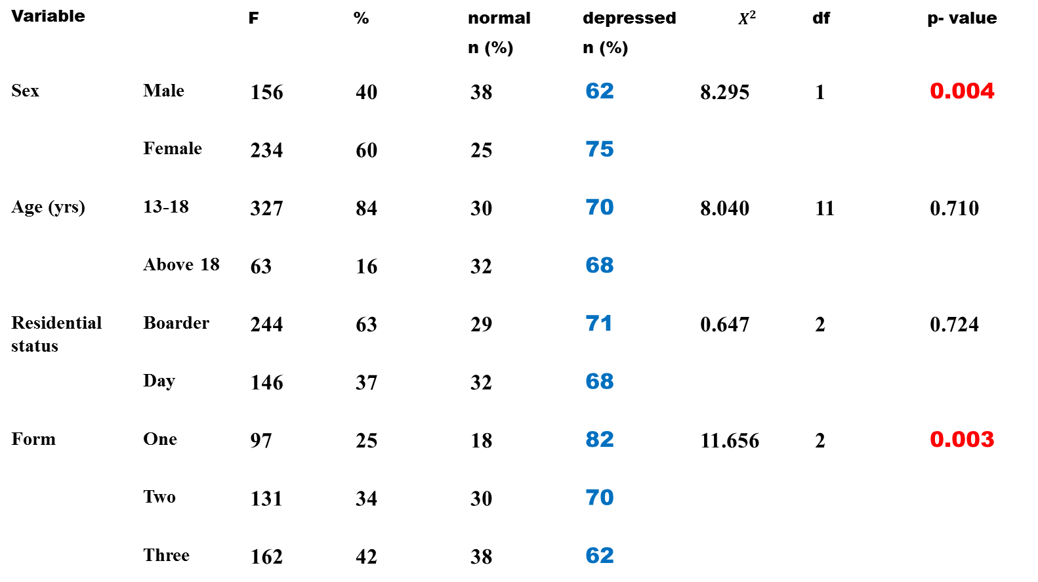
2.2 Demographics and depression
Variable |  | F | % | normal n (%) | depressed n (%) | $$X^{2}$$ | df | p- value
Sex | Male | 156 | 40 | 38 | 62 | 8.295 | 1 | 0.004
 | Female | 234 | 60 | 25 | 75
Age (yrs) | 13-18 | 327 | 84 | 30 | 70 | 8.040 | 11 | 0.710
 | Above 18 | 63 | 16 | 32 | 68
Residential status | Boarder | 244 | 63 | 29 | 71 | 0.647 | 2 | 0.724
 | Day | 146 | 37 | 32 | 68
Form | One | 97 | 25 | 18 | 82 | 11.656 | 2 | 0.003
 | Two | 131 | 34 | 30 | 70
 | Three | 162 | 42 | 38 | 62

Slide 15
Associations of Social antecedents on stress, anxiety and depression

Slide 16
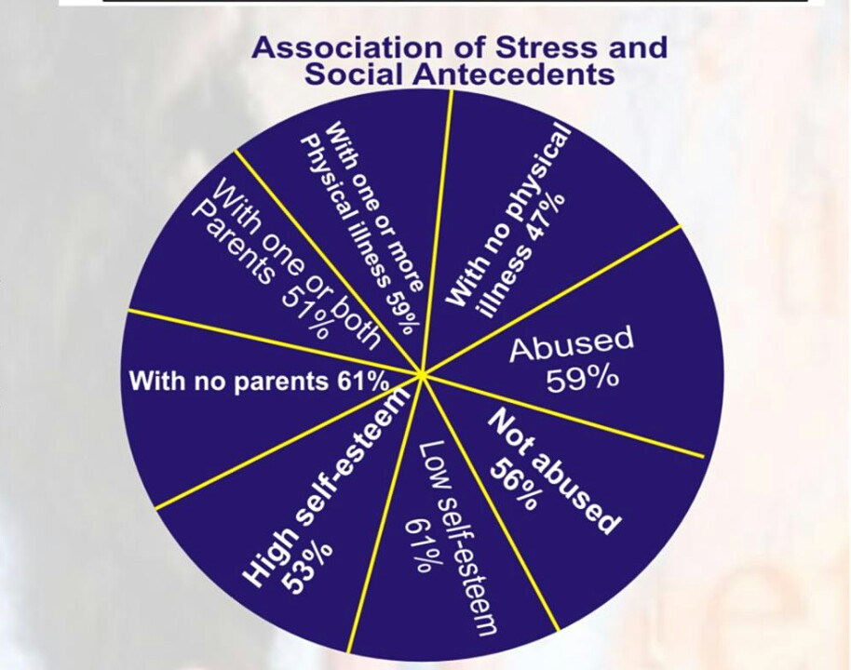

Slide 17
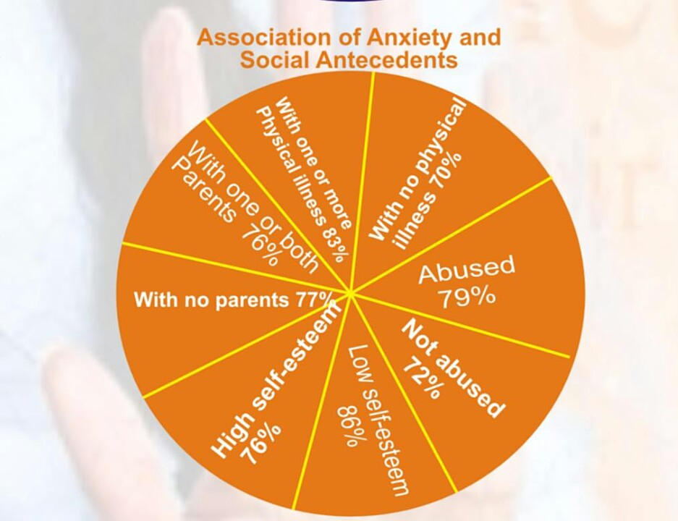

Slide 18
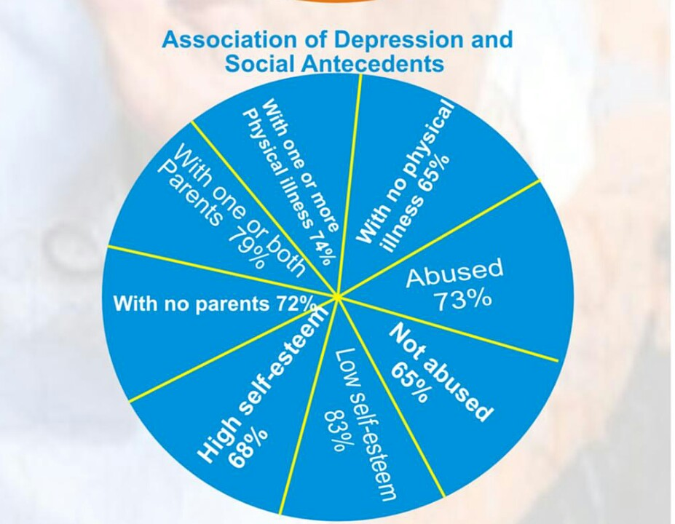

Slide 19
Conclusion 1/2
The study indicates a high prevalence of all the three disorders: 53% for stress, 77% for anxiety and 70% for depression.
Form one students recorded the highest percentages in all the three disorders
Levels of anxiety and depression were sex dependant, higher in females than males.
Boarders perceive more stress as compared to day students
Anxiety as significantly dependant on health status, likewise stress on abuse

Slide 20
Conclusion 2/2
The study establishes association between: physical health & depression, and physical health & stress
The study as well establishes associations of depression, anxiety and stress on self-esteem

Slide 21
Recommendations 1/2
Mental health assessment is an essential component throughout life from childhood to old age. For that matter, there must be a great focus on adolescent mental health as they start forming social relationships, appearing in diverse environments for educational and other purposes and undergoing some physiological changes, for all these could have impact on their mental health.

Slide 22
How ???

Slide 23
Recommendation 2/2
There must be a strong advocacy on mental health and well-being in a form of seminar for junior and senior high school students.
Moreover, is very necessary to establish counseling units in the various junior and senior high schools.
This could be achieved through a multi-disciplinary approach of the government, mental health professionals, parents, teachers, and traditional and religious leaders.

Slide 24
TAKE HOME NOTE
If the same quantum of epidemiologic attention given to MALARIA in Africa is given to MENTAL HEALTH, there would be great minds and more brilliant ideas to eliminate MALARIA.
Ahmed Atuahene
THANK YOU

Slide 25
References
Kelly, CM, Kitchener BA. (2010). Youth Mental Health First Aid: A manual for adult assisting young people. 2nd ed. Melbourne, Australia.
Lovibond, SH., & Lovibond, P.F. (1995). Manual for the Depression Anxiety & Stress Scales. (2nd Ed.)
Steel, Z. et al (2014). The global prevalence of common mental disorders: A systematic review and meta-analysis 1980-2013. International Journal of Epidemiology, 43(2), 476-493. doi:10.1093/ije/dyu038.
The Royal College of Psychiatrists. (2010). No Health Without Public Mental Health.
World Health Organization. (2016). Fact sheet reviewed. Retrieved on February 2, 2017 from http://www.who.int/whr/2016/media_centre/press_release/en/

